Slide 1
YOU Can Make This!
Presented by: insert your name and credentials here
Prepared by Joanne Linowes, Leadership Educator
Wing Wong, P.E.
Ed Baumann, P.E.
Maddie DeClerck, P.E.
And the ACEC/MA Leadership Education Committee

Slide 2
Notes:
Opening montage. If you like, you can add your own photos on additional slides.

Slide 3
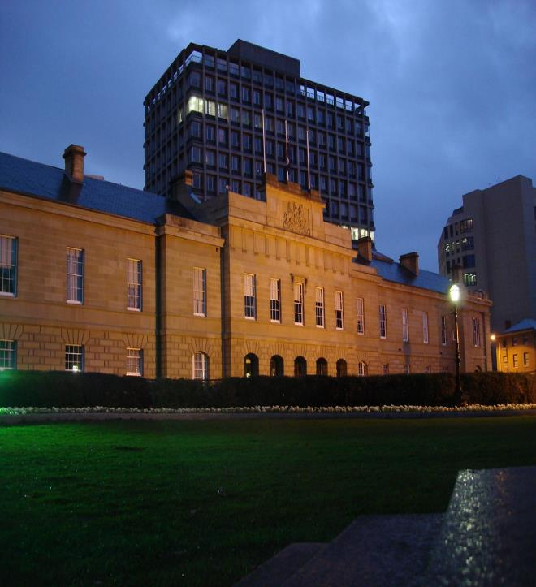
Notes:
Photo 1 by Unknown Author is licensed under CC BY-SA (https://en.wikipedia.org/wiki/Jewel_House)
Photo 2 by Unknown Author is licensed under CC BY (https://www.flickr.com/photos/jlascar/4551936219)

Slide 4
Notes:
Source: visitsingapore.com

Slide 5
Notes:
This Photo by Unknown Author is licensed under CC BY-SA

Slide 6
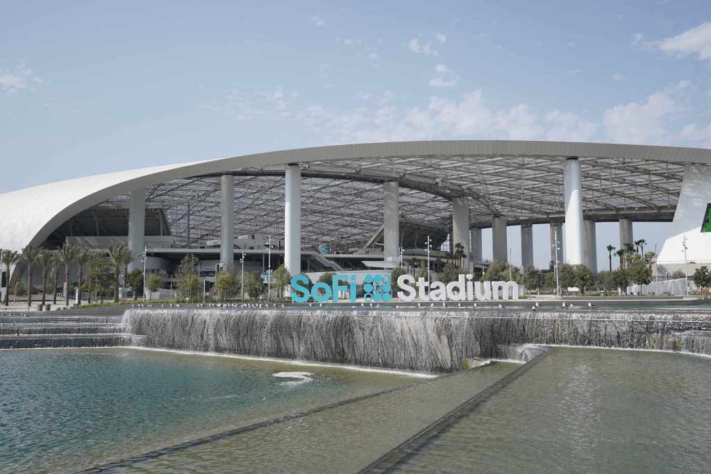
Notes:
Source: USAToday

Slide 7
Notes:
Source: Architectural Digest

Slide 8
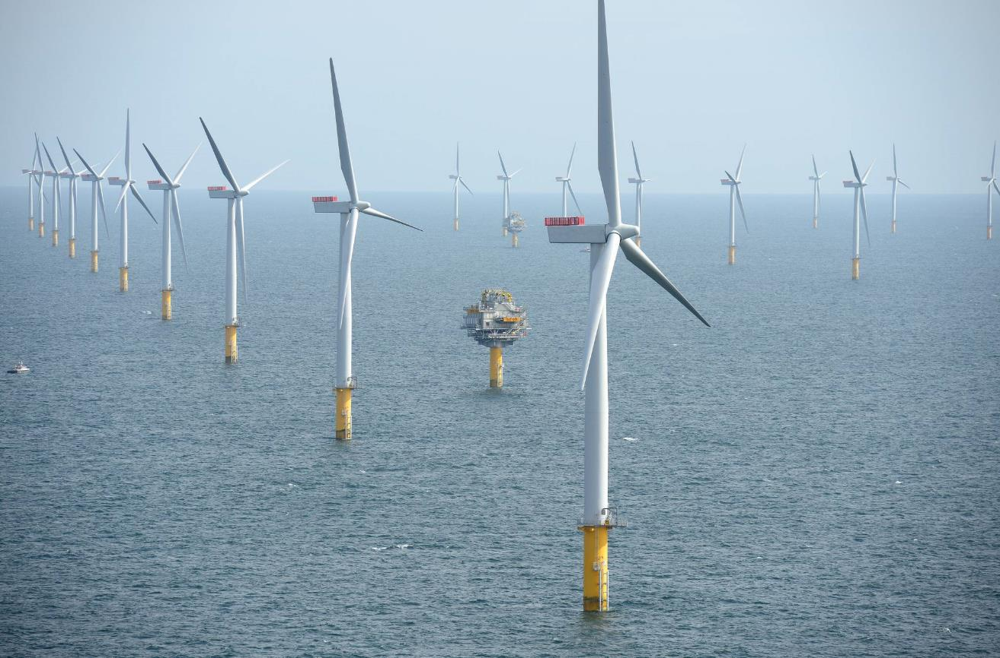
Notes:
This Photo by Unknown Author is licensed under CC BY-SA

Slide 9
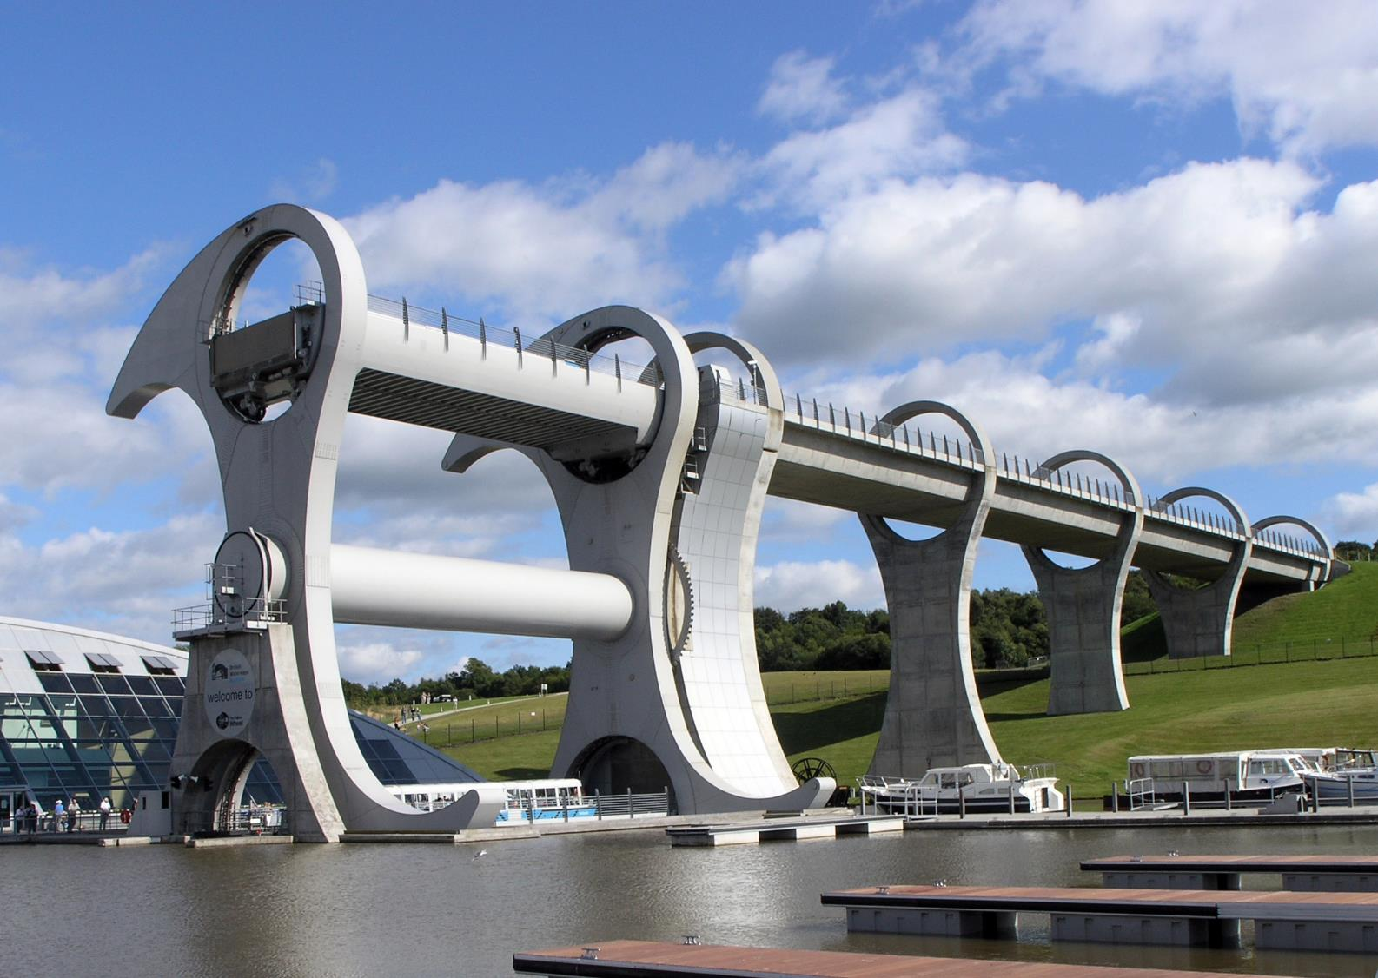
The Falkirk Wheel ← in Scotland
Notes:
This Photo by Unknown Author is licensed under CC BY-SA

Slide 10
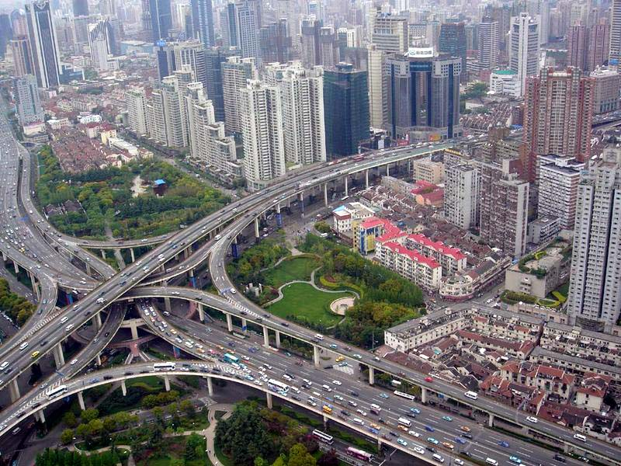
A multi-level stack interchange, buildings, houses, and park in Shanghai, China

Slide 11
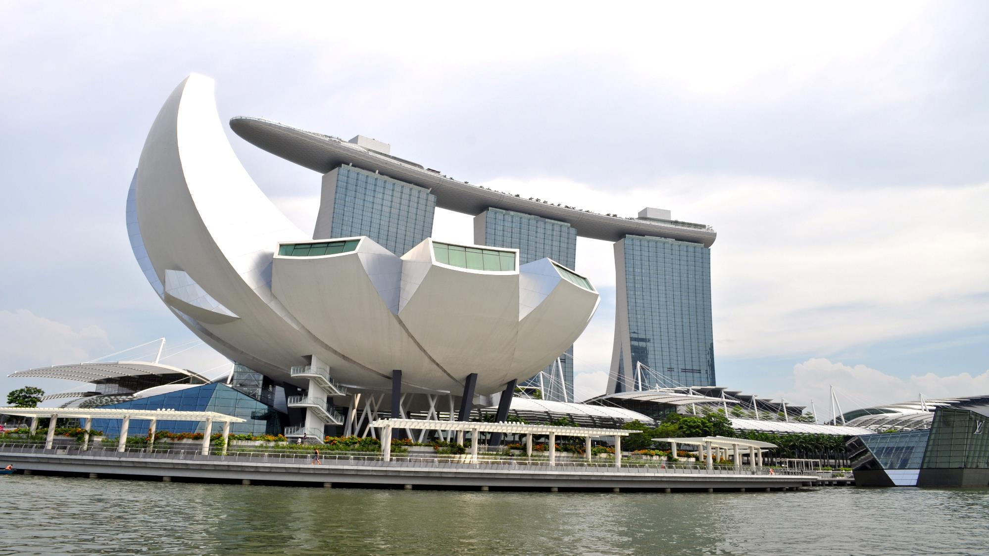

Slide 13
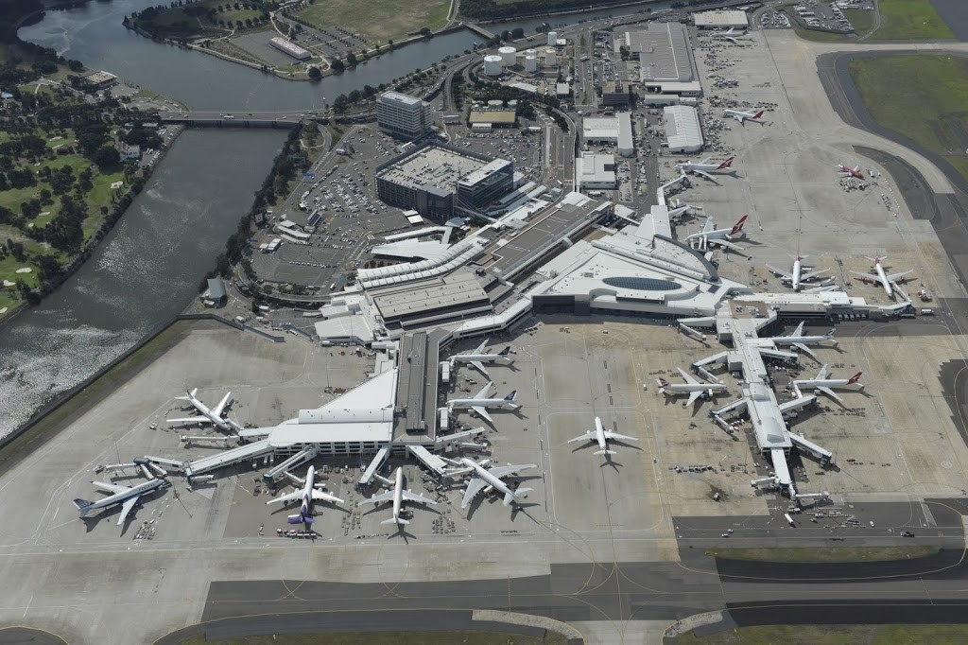
Sydney Airport, Sydney, Australia
Notes:
This Photo by Unknown Author is licensed under CC BY-NC (https://travelshopgirl.com/taking-airport-link-from-the-airport-to-circular-quay-sydney-australia/)

Slide 15
True Story . . .
Notes:
This is where you tell your 3 minute personal story. NOT “I always wanted to be an engineer” NOT “I never thought I’d be an engineer” – tell an incident that shows you as a kid their age that impacted you and pushed you into this career.

Slide 16
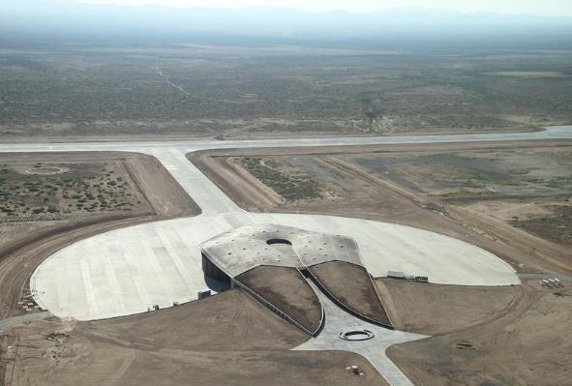
1. How do things get designed?
Every place, structure, system, and product is designed by engineers – in many different engineering fields. An engineer designs anything before it can be built.
Source: space.com

Slide 17
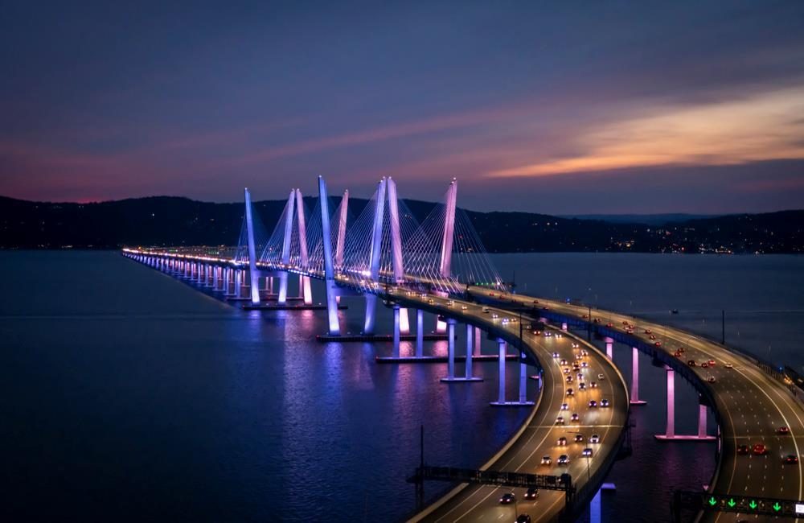
2. Creating Our World!
We produce interesting AND useful ways to make our lives and environments better through what we design, and then these things get built. Engineers are problem solvers! We always ask: how can something be better?
Source: ITS International

Slide 18
What kinds of problems do engineers solve?
How you and vehicles can cross a body of water
What are the best ways to get around in an airport
How to get pedestrians and bicyclists safely to share the roads with cars
How to explore space
How to explore under the oceans
How to prevent floods; ways to drain flood water
How to protect natural habitats and wetlands
How to build skyscrapers
How to move people from place to place
How to make things work more efficiently
How and where to place a building on a piece of land
Notes:
These are examples. You are welcome to create your own list. Name some problems you and your firm address for your clients.
Keep this section to 2 minutes.

Slide 19
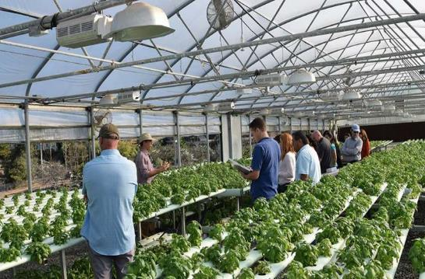
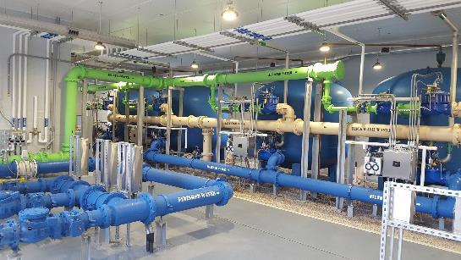
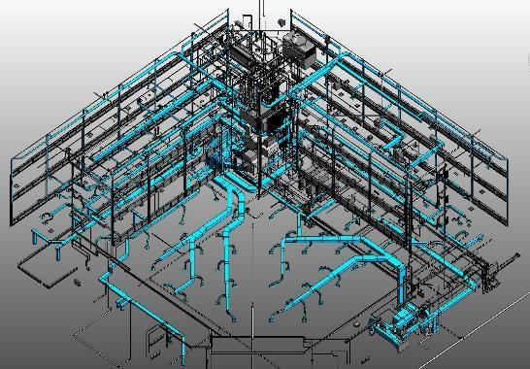
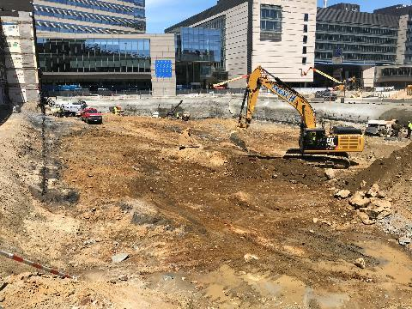
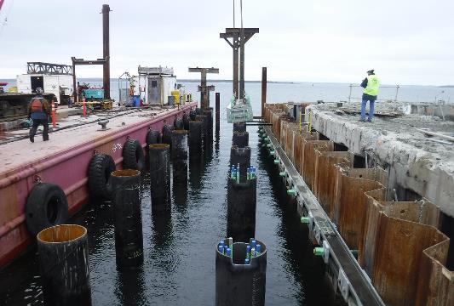
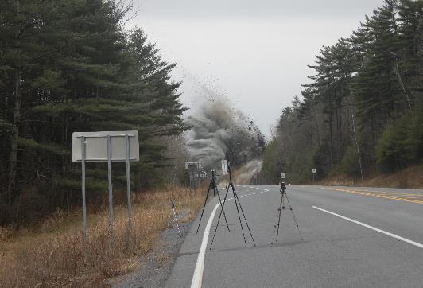
3. Different Kinds of Engineering
Different things are designed by different kinds of engineering expertise. What types of engineers are there?

Slide 20
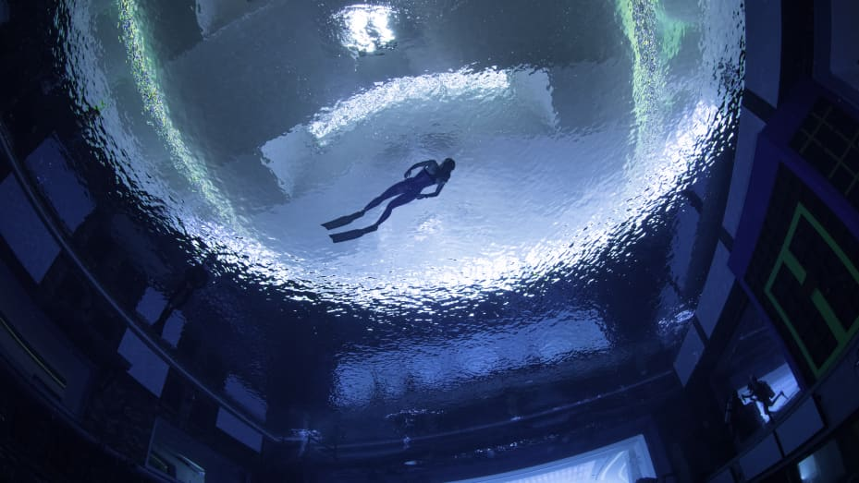

Slide 21
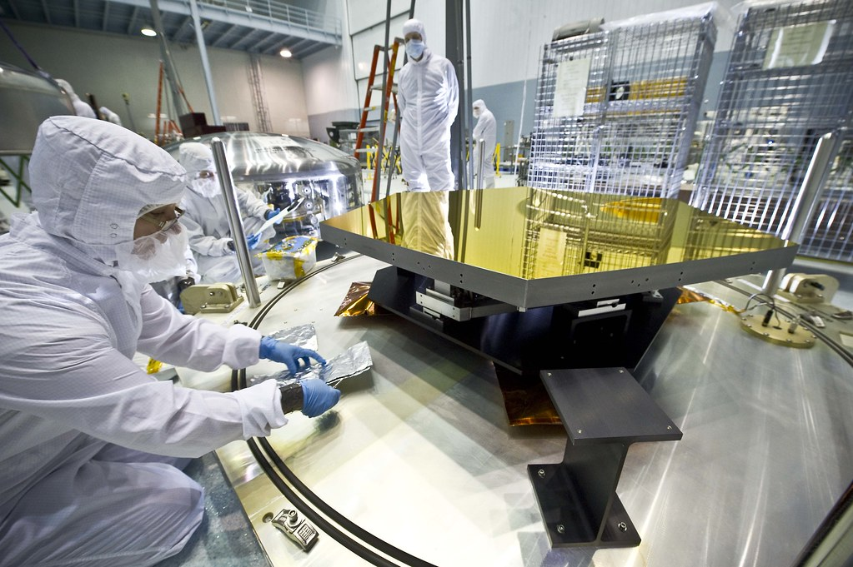
This Photo by Unknown Author is licensed under CC BY

Slide 22
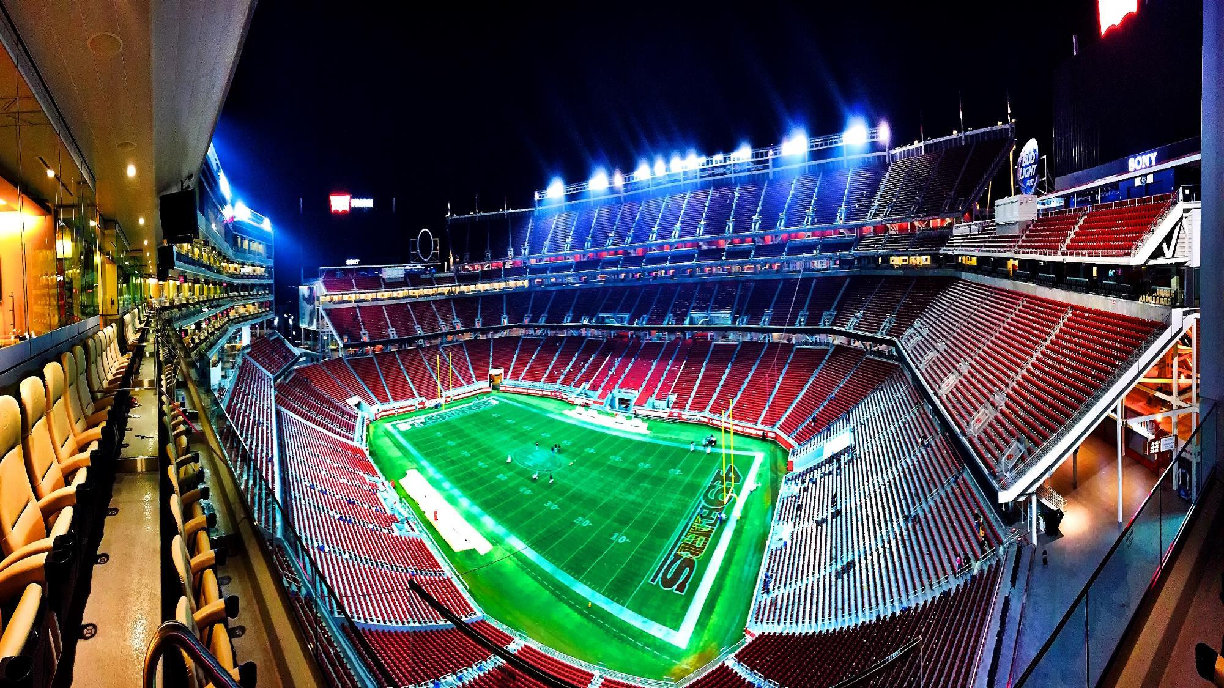

Slide 23
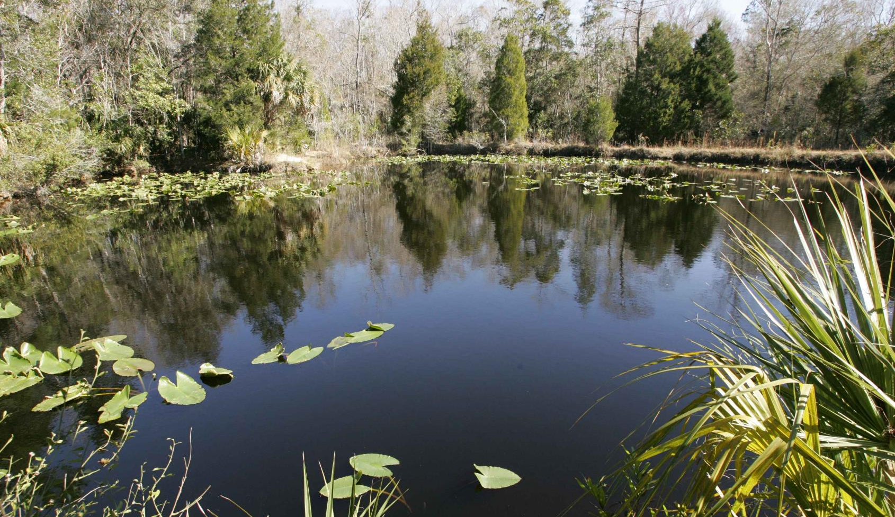

Slide 26
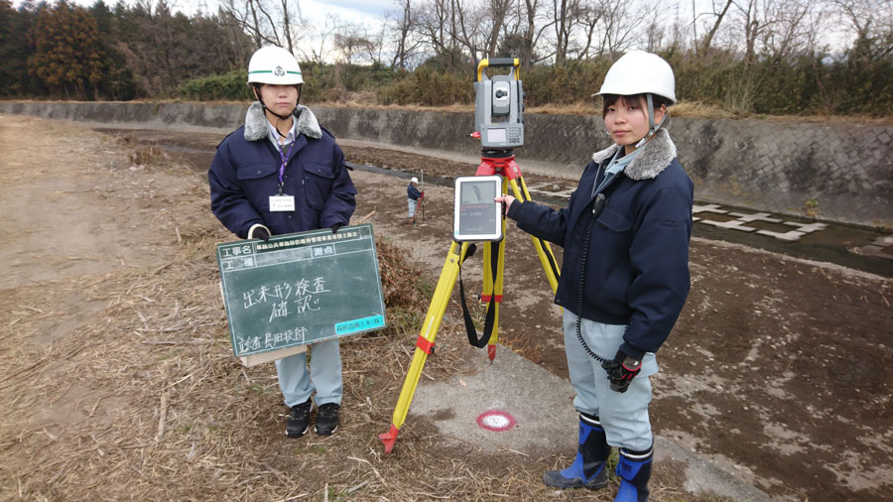

Slide 27
Different Kinds of Engineers:
MEP engineers design systems such as heating and cooling, electrical, fire protection, and plumbing to provide fresh water for drinking, cleansing and more ….
Mechanical engineers design robots and mechanical arms, factory automation, . . .
Electrical engineers design space apparatus, military defense apparatus, laser technology, . . .
Chemical engineers design oil and natural gas energy systems, applications for biodegradable plastics,……
Water/hydro engineers design water systems for cities, hydroponic greenhouses, manufacturing plants wastewater filtration, desalination systems, . . .
Civil engineers design . . . cities, airports, housing developments, . .
Structural engineers design bridges, buildings, houses, walls, tunnels, . . .
Transportation engineers design railroads, roads, public transit systems, . . .
Systems engineers design computers, software, games, . . .
Aerospace engineers design rockets, space exploration vehicles, satellites, . . .
Notes:
If you want, add more. You do not need to read all these, you could just name a few. Just remember this slide should only take about 1 minute.

Slide 28
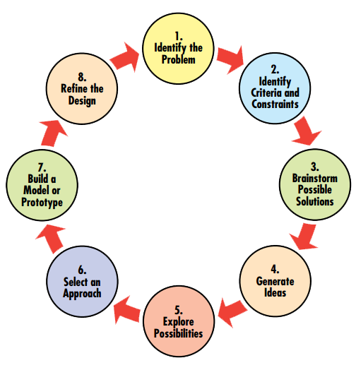
4. How does the work happen?
To do this, I (and all engineers) work as a team . . .
The following are 7 steps in how the process works,
from the first idea to finished project:

Slide 29
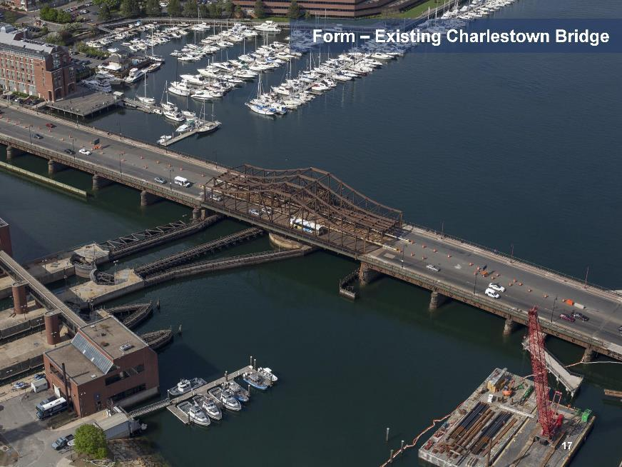
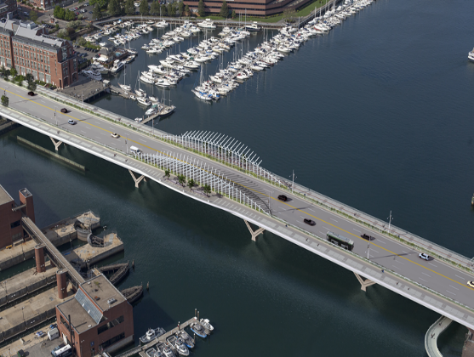
Step 1: Dream the Idea – Get Inspiration. Think about the problem you are solving.
What’s out there today
Visualize the Future
Photo courtesy of Boston Public Works Department
Notes:
Explain that this is before and after – the existing and the dream

Slide 30
Step 2: Assemble Team!

Slide 31
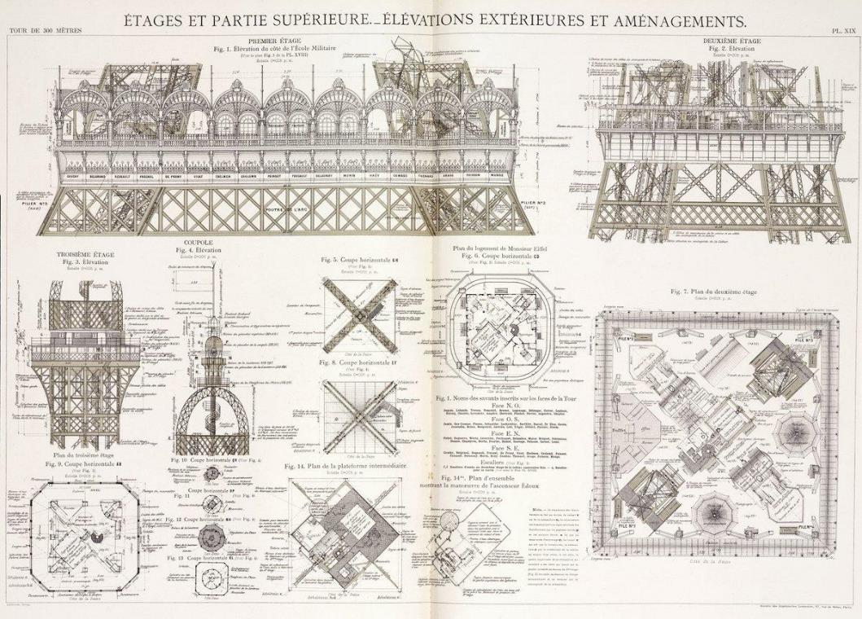
Step 3. Do some general sketches to get your ideas down.
Source: Science Museum
Source: Fine Art America
Notes:
Explain in one sentence what are sketches and how they are produced with today’s technology

Slide 32
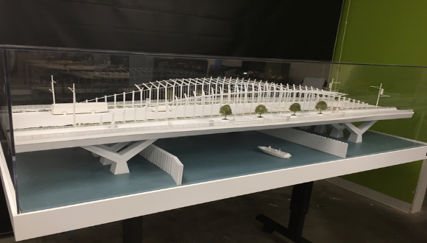
Step 4: Create Initial Model (computer or real life)
Notes:
Show this as an example of a model to explain preliminary design. We are using this bridge as an example. OR You can insert your own project if you prefer. You will need to replace this slide (#41) and also 43, 44, 46.
In this slide, point out 3 key items that you will use as an example to show how an element of design evolves. Point to these items and tell the kids you will show them how it goes from idea to something that can be constructed.

Slide 33
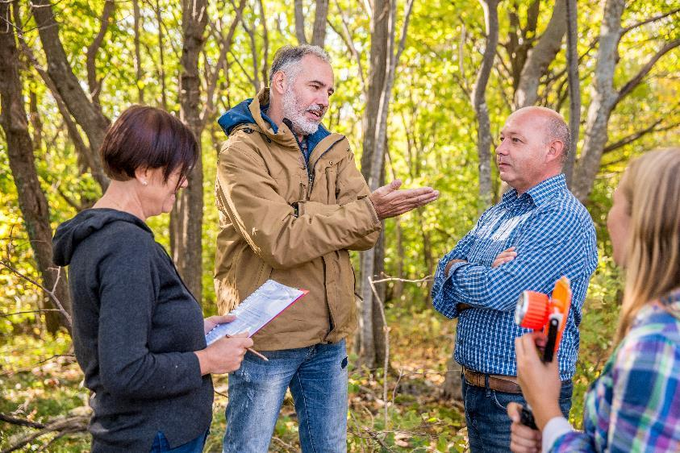
Step 5: Find out what the neighbors, community, local businesses, & local officials think of the plans.

Slide 34
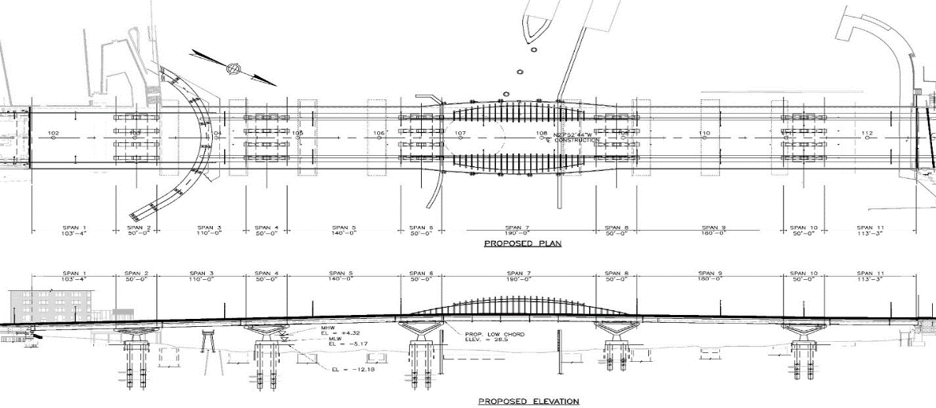
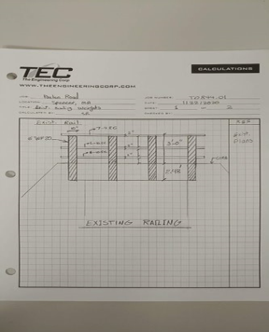
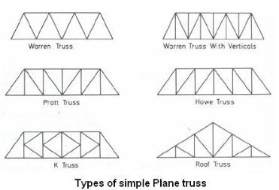
Step 6: Develop the design, using calculations, brainpower, consultation with team members, . . . to get the project or idea to different levels of completion.
Sometimes you do hand drawings, sometimes computer design tools, sometimes BIM, sometimes animated. Designs are developed in a variety of both basic and sophisticated ways, one element at a time…
This Photo by Unknown Author is licensed under CC BY-SA
Notes:
Show the same 3 items we saw in preliminary design and point out verrry briefly how they evolve from idea to something constructable.

Slide 35
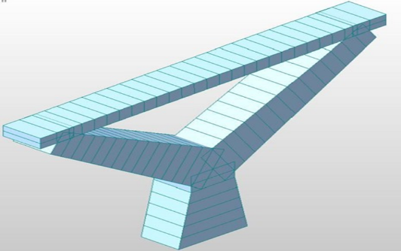
Different forms of visuals are all part of the design process!
Notes:
Explain how different forms of visuals are part of the design process.

Slide 36
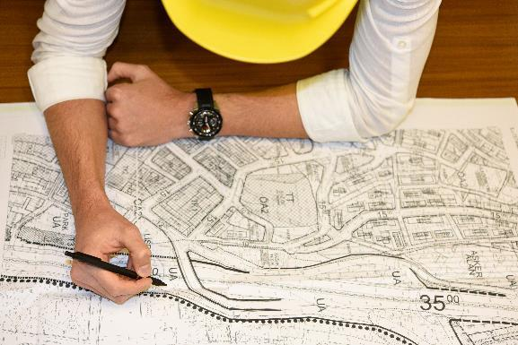
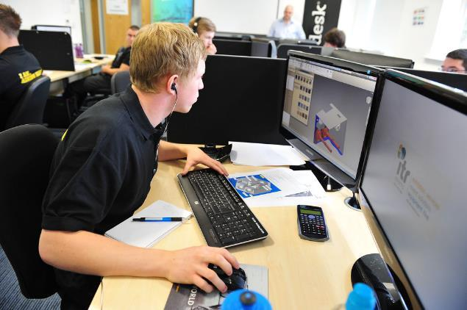
After review and continuous refinement, we get to 75% design, and you can see these same items have evolved to be more complete, sophisticated, and perfected.
Every day we move the job along, one-step at a time, seeing progress and sometimes completely re-doing one part or another because we think of a better way to do it, or we discover more complicated issues we need to address.
Often what we envisioned in the preliminary design gets changed when we learn more about the project and the things that affect what we want to deliver.
This is where creative thinking, trial-and-error, alternative ideas, and experimentation come in – until we get it right.
This Photo by Unknown Author is licensed under CC BY
Notes:
Keeping the bridge example from preliminary design slide, you can explain here these steps in the process, then quickly get to the next slide which is the finished bridge. If you want to insert your own project here because you kno
w it, then do so.

Slide 37
Step 7: Complete the Project!
After thinking, creating, trying ideas, designing, and testing throughout the whole design process – sometimes for months, sometimes years, here is the finished project. The bridge you see, the road you drive on, the park you play in, the engineers made it happen!
Notes:
With great enthusiasm, show this or if you substituted your own project in slides 41, 43, 44 a photo of your own finished project! Point out one or two things to draw their attention to. Say “Notice the ._______. That was designed using ____________”

Slide 38
5. Let’s take a look: What are you good at?
What kinds of projects do you like to do? What are your best skills? What are you good at? How can what you like, and do well help put you into the exciting innovative world of design and creation of technical and engineering projects?
Can you guess? The skills you need to do engineering are . . .
That means, in middle school, high school and college, you get to study the special subjects that prepare you for work that involves engineering.
So, in addition to really getting good at reading and writing, you will want to learn about the environment and what people need for a safe and good life. You will want to choose courses in geography, a few levels of math, different sciences including geology and biology and physics, art, history, technology.
Notes:
For bullets one and two, you might want to open this up to discussion. These can be used as discussion-starter questions.

Slide 39
6. Can you learn on-the-job?
It’s not all about school! Get some good experiences! Summer programs and volunteer jobs will help you get ready for a career in all types of engineering. Ask around to find opportunities in your community. Don’t be shy.
When you major in Engineering in college, once you have completed your courses and exams, you will have a B.S. in Engineering degree. Then you will work as an Engineer-in-Training where you are part of the actual job team while getting real experience.

Slide 40
7. Activity Time!
*Add Activity Here*
Notes:
You will need to plan ahead. Whichever activity you use, make it a meaningful and MEMORABLE experience. Show enthusiasm. Give clear, specific yet simple directions.
This is a 20 minute activity you can do virtually or in person, called Let’s Create a Problem You Can Solve
Remember, your whole classroom visit may only be 45 minutes, so plan an appropriate activity.
You may use the one on the following slides
OR You might also choose some other activity, as mentioned at the outset of this training module. Just be sure you can complete it in 15-20 minutes and that it is appropriate for either in person or virtual (whichever you are doing)
Suggest breaking the class into groups of 3-5 students, in person or using virtual break-out rooms.

Slide 41
Since engineers are problem solvers, let’s tackle a problem!
Here’s the situation. Listen carefully and you might want to jot down details.
B. 1. What problem are we trying to solve? Make a problem statement. Why is this an important problem to solve? What would happen if we do nothing?
2. What do we need to think about in order to solve this problem?
3. What might get in the way of making your ideas happen?
C. What did we learn?
Each situation presents a problem to solve.
A team works together to share ideas and skills to solve the problem.
The best solution is innovative, safe, and improves life.
Notes:
Describe a situation you invent or from resource materials you have from a STEM source. Make it a solvable problem. Explain it in a 2 minute description, with all the factors, elements, etc. you would encounter if a client came to you with a situation.
Explain that the process of engineering design begins with hearing and examining the facts and the situation so you can make a problem statement (something simple like: how can I cross the stream to get to school faster and easier than walking around the whole neighborhood)
Their job is to listen to your description, then work in the small group to come up with a problem statement and how they might approach the situation. This should take about 8 minutes. Then the group comes back together and each breakout group tells their problem statement. After that, take about 6 minutes to process the exercise.
Use the questions below to guide the activity.

Slide 42
7. Let’s recap today’s visit!
*https://link.edgepilot.com/s/28342ba0/PHkGhH91WUuGjj5fIr63Kw?u=https://www.youtube.com/watch?v=nMwG1wnESDA
Notes:
This is an alternate slide in case it’s not possible to perform an activity during the visit. If this is the case, delete the previous two slides.

Slide 43
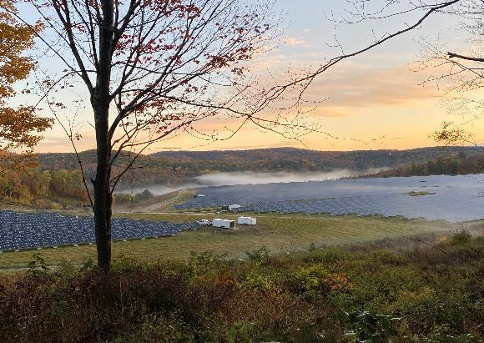
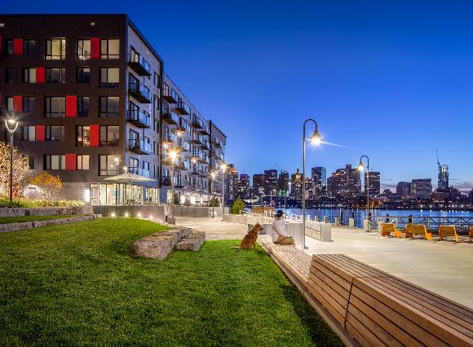
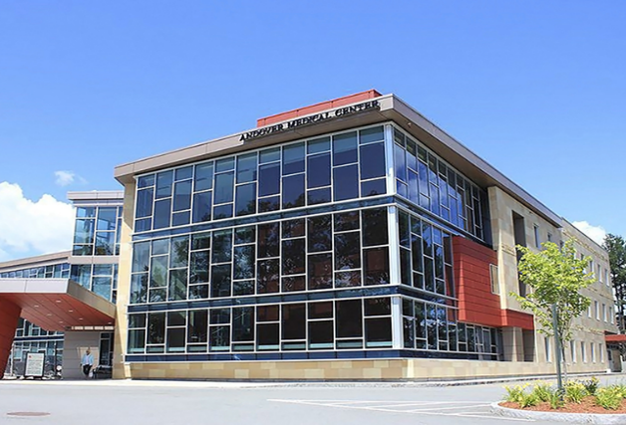
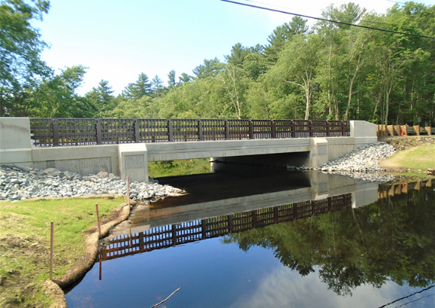
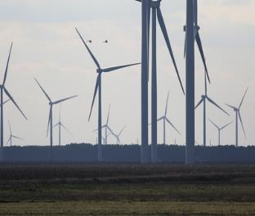
8. Look Around
Take a look at the neighborhood around you, the roads, the buildings, the parks, the water, the bridges, the shopping centers . . . a civil engineer and a land surveyor work to create all these things.

Slide 44
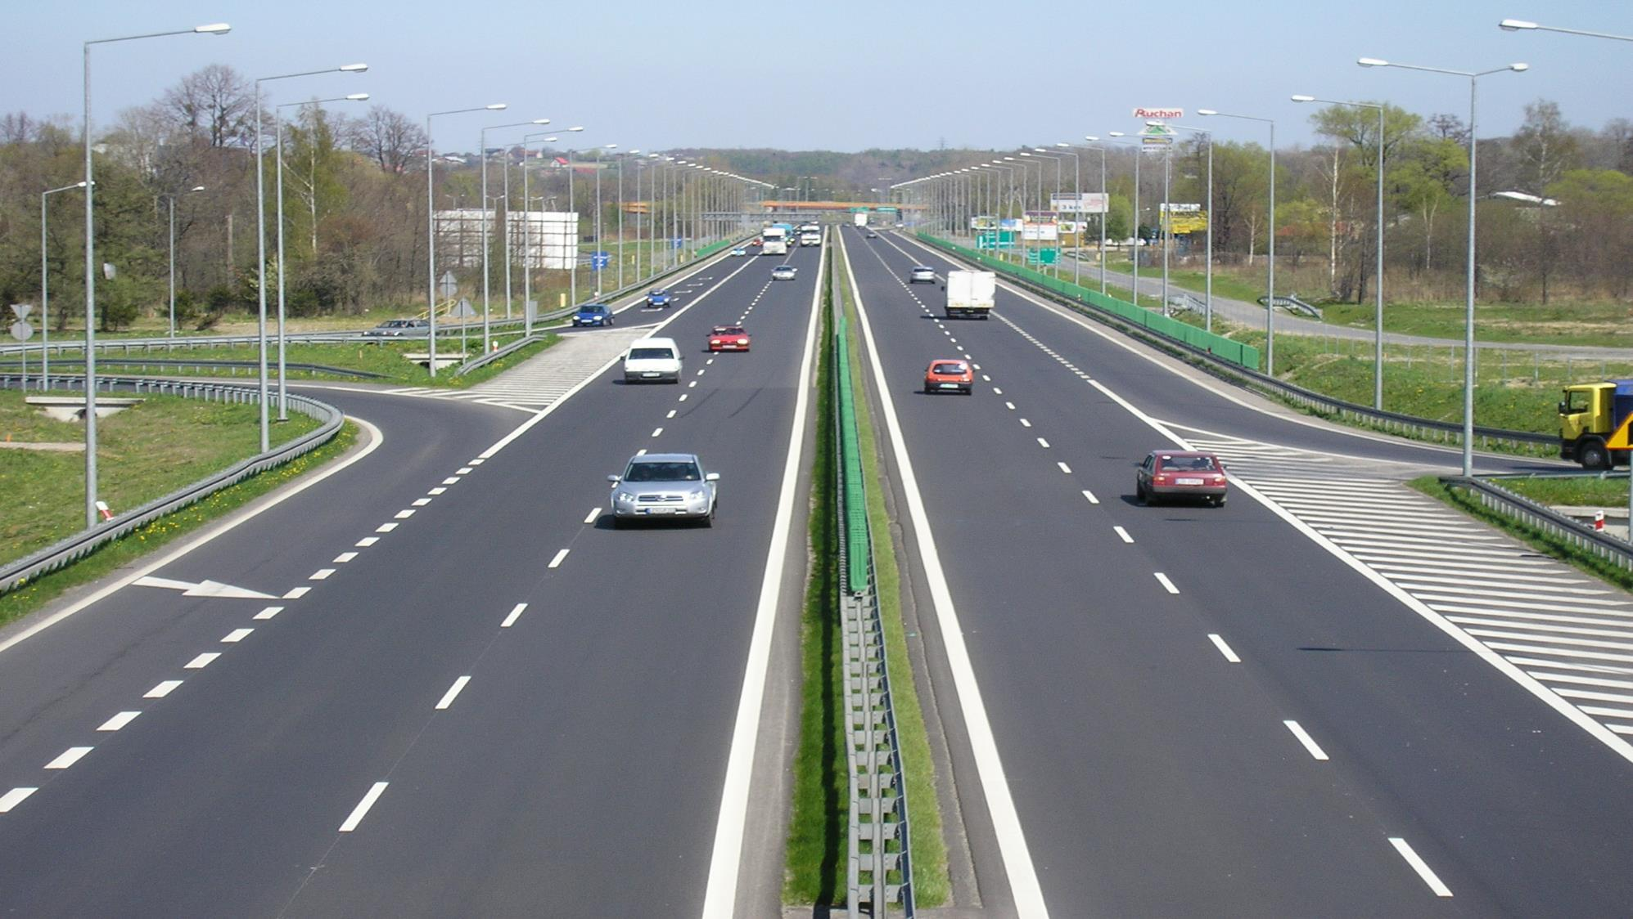
Notes:
This Photo by Unknown Author is licensed under CC BY-SA

Slide 45
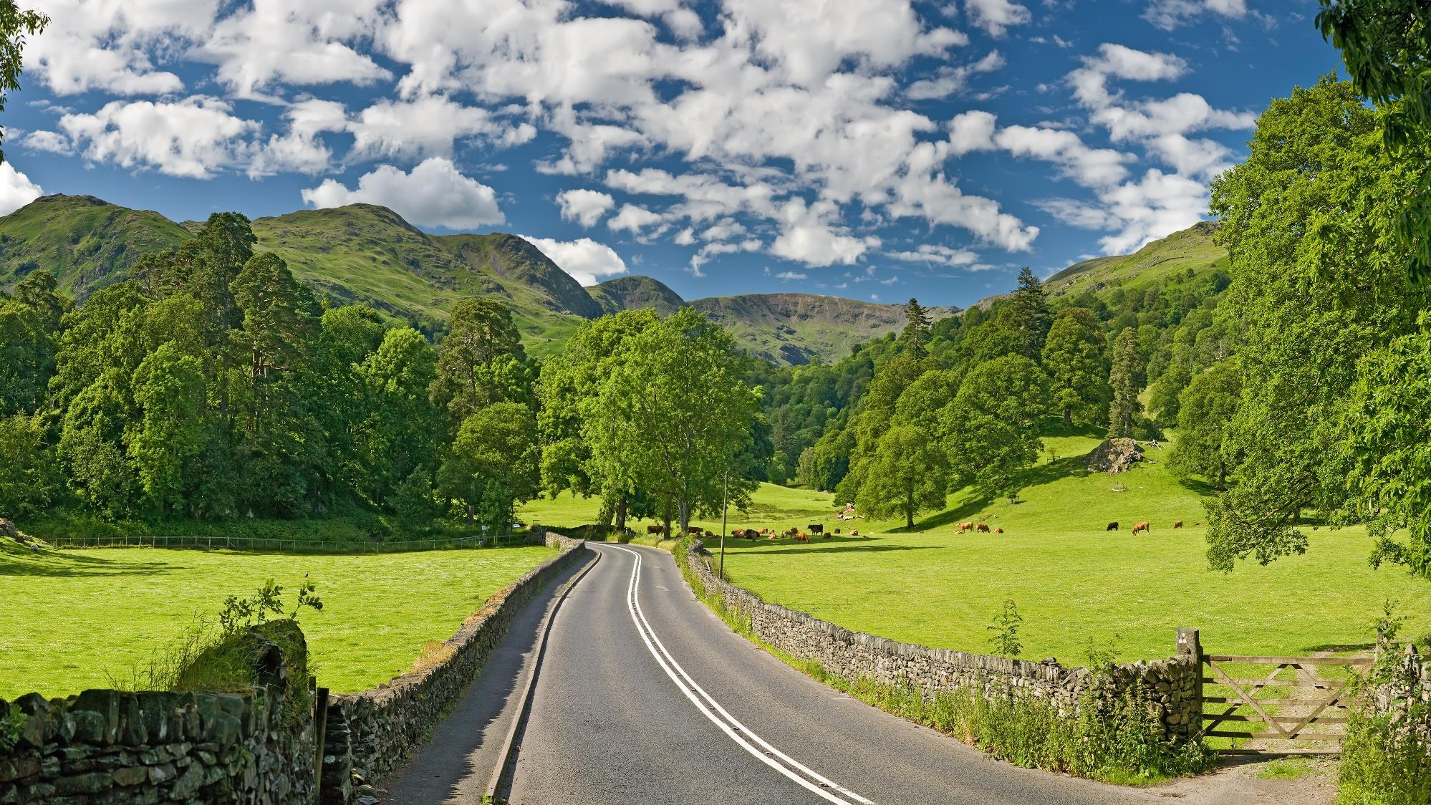
Notes:
This Photo by Unknown Author is licensed under CC BY-SA

Slide 46
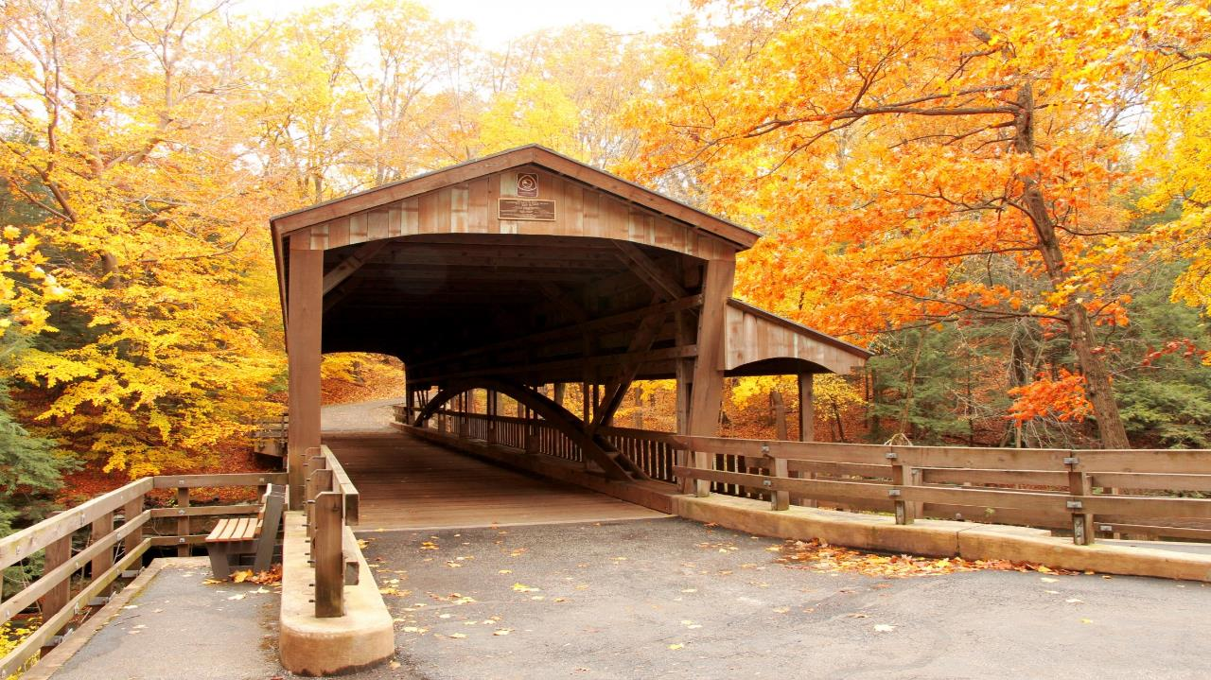

Slide 47
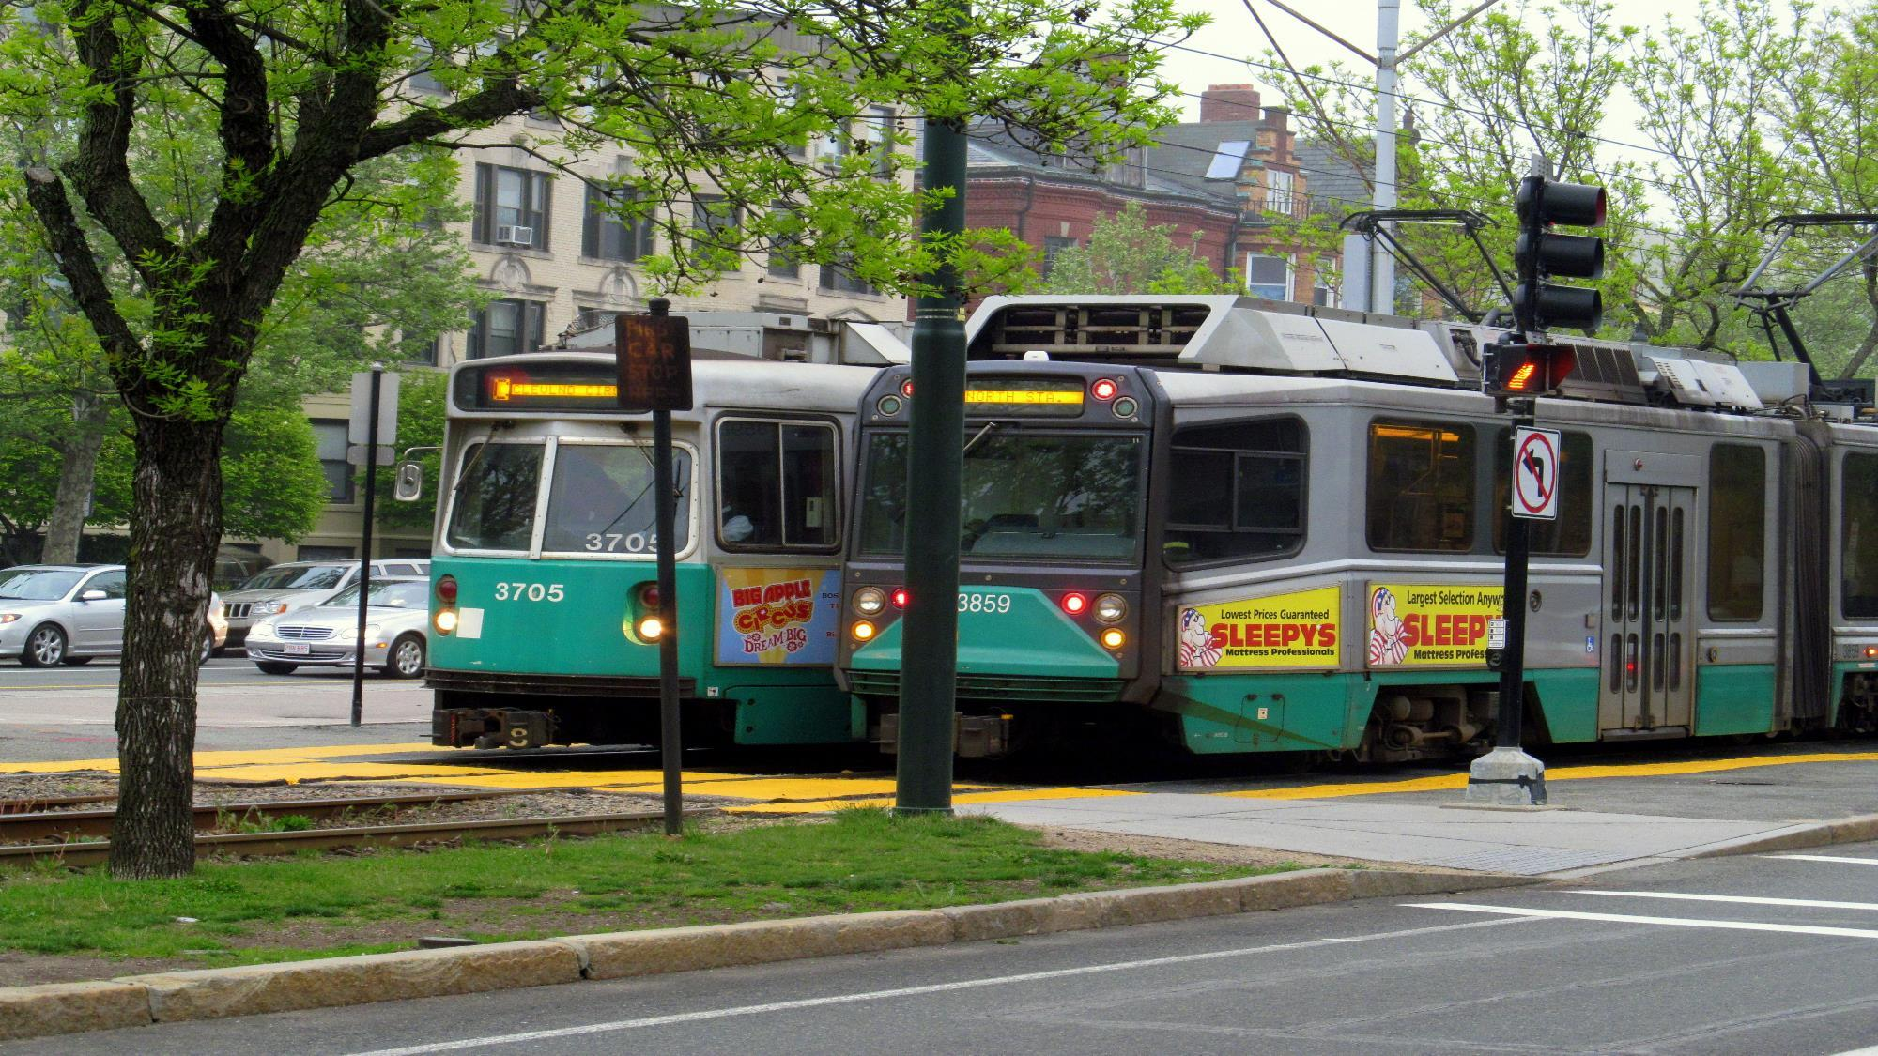
Notes:
This Photo by Unknown Author is licensed under CC BY-SA

Slide 48
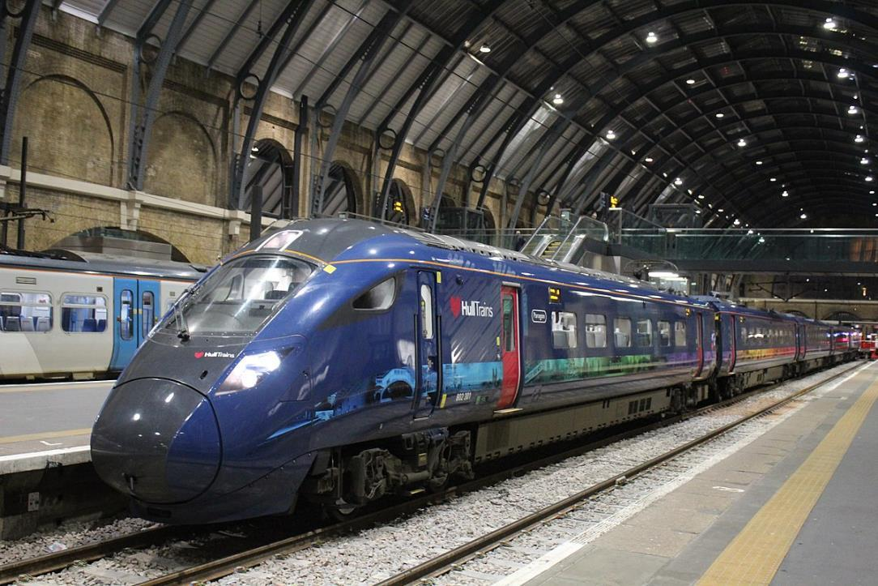
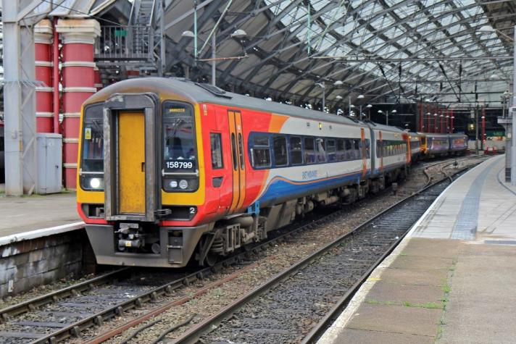
Notes:
This Photo by Unknown Author is licensed under CC BY-SA
This Photo by Unknown Author is licensed under CC BY-SA

Slide 49
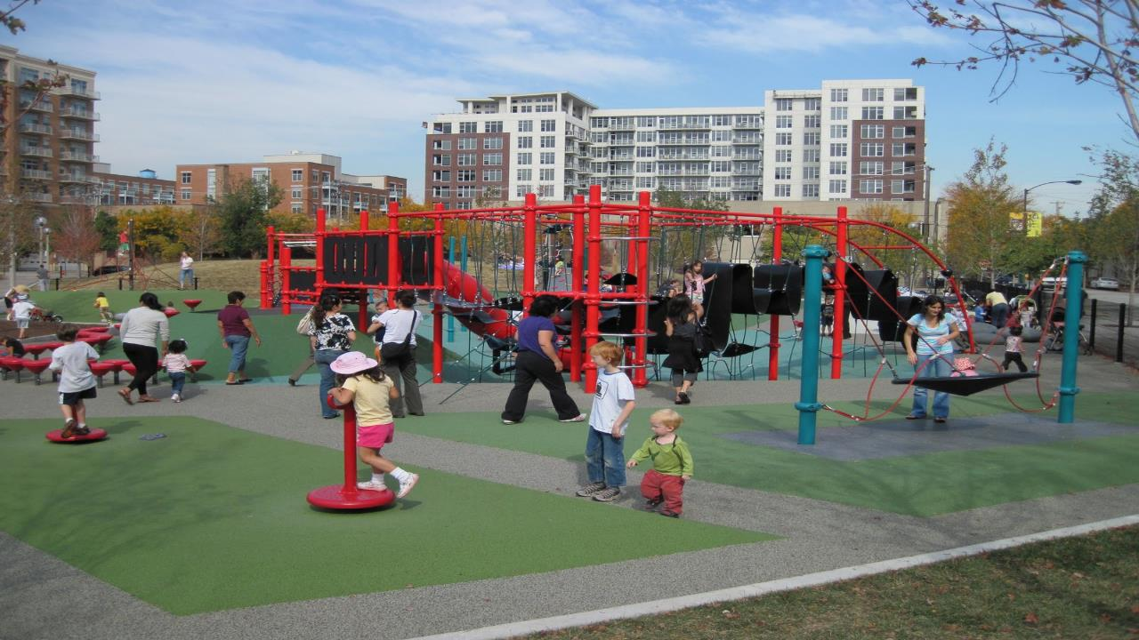
Notes:
This Photo by Unknown Author is licensed under CC BY-NC-ND

Slide 50
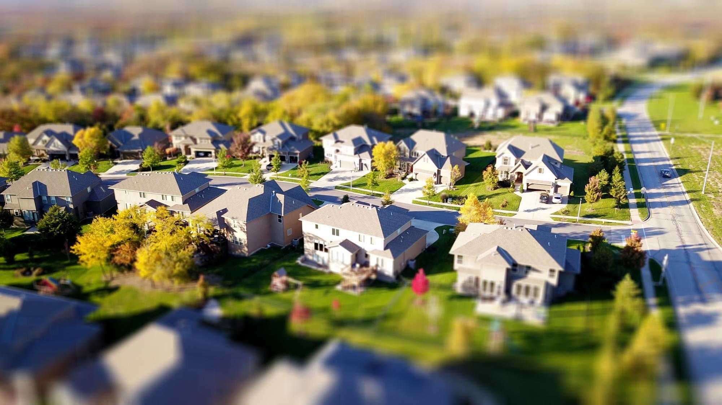

Slide 53
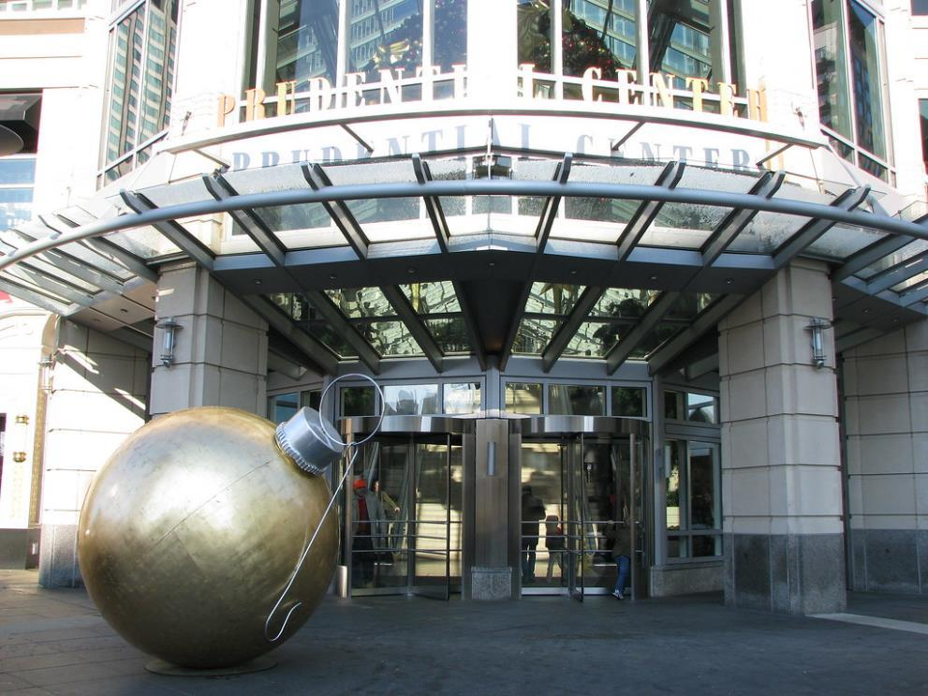
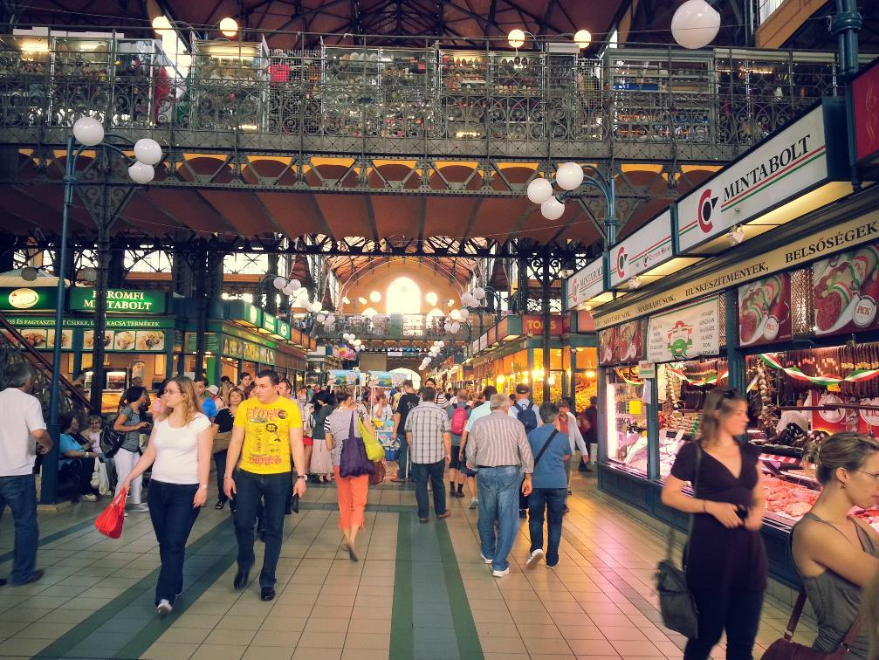
This Photo by Unknown Author is licensed under CC BY

Slide 54
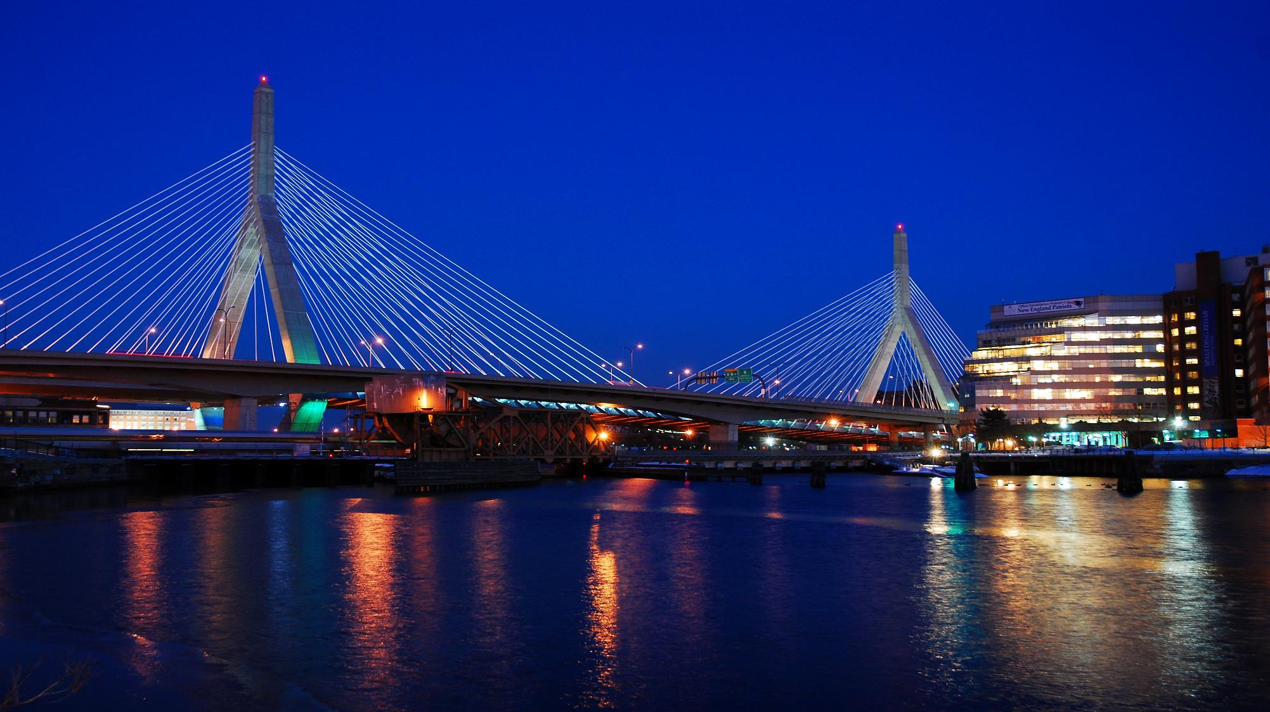

Slide 55
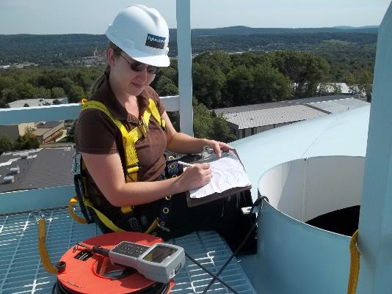
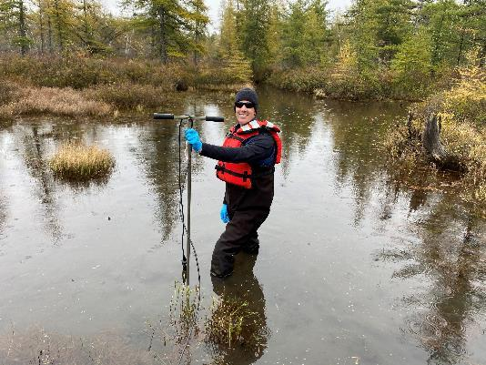
9. What about you?
As you think about the work you want to do, just remember as an engineer, YOU can make this!
Notes:
Show a couple of the ending photo slides but THIS is the slide you should keep up during Q&A.

Slide 57
This Photo by Unknown Author is licensed under CC BY

Slide 59
This Photo by Unknown Author is licensed under CC BY-ND

Slide 60
10. You can make a difference! Our world needs YOU!
Notes:
This Photo by Unknown Author is licensed under CC BY-SA-NC

Slide 61
Notes:
These Photos by Unknown Author is licensed under CC BY-SA-NC

Slide 62
Notes:
This Photo by Unknown Author is licensed under CC BY-SA-NC
This Photo by Unknown Author is licensed under CC BY-SA-NC

Slide 63
Notes:
These Photos by Unknown Author is licensed under CC BY-SA-NC

Slide 64
Notes:
These Photos by Unknown Author is licensed under CC BY-SA-NC

Slide 65
Notes:
These Photos by Unknown Author is licensed under CC BY-SA-NC

Slide 66
Notes:
These Photos by Unknown Author is licensed under CC BY-SA-NC

Slide 67
Notes:
These Photos by Unknown Author is licensed under CC BY-SA-NC

Slide 68
Notes:
These Photos by Unknown Author is licensed under CC BY-SA-NC

Slide 69
Where is more information?
www.acecma.org
www.acementor.org
www.bsces.org
www.discovere.org
www.futurecity.org
www.mass-stemhub.org
www.nspe.org
www.nsta.org
www.same.org
www.wtsinternational.org
swe.org

Slide 70
Questions?

