Slide 1
American Council of Engineering Companies IS Forum
Nick DeLena, Principal, IT Risk Assurance & Advisory
Scott Goodwin, Manager, IT Risk Assurance & Advisory
October 14, 2021

Slide 2
WELCOME
Scott Goodwin
Scott is a Manager in the firm’s Business Advisory Group and a team member of the IT Risk Assurance & Advisory practice. He has extensive experience across a wide variety of areas including vulnerability assessments, infrastructure and application penetration testing, social engineering, along with compliance-focused capabilities including CMMC and DFARS assessment, information security program development and implementation, and fractional CISO services.
Scott holds several industry standard information security and penetration testing certifications including: Certified Ethical Hacker (C|EH), Offensive Security Certified Professional (OSCP), Offensive Security Wireless Professional (OSWP), Security+, Microsoft Security Technology Associate, as well as a number of vendor and technology specific certifications. His experience in the technical areas of the infosec industry has allowed him to identify several previously unknown security vulnerabilities in commercial software during client penetration tests.
Vulnerability Credits
CVE-2018-11628, CVE-2019-7004, CVE-2019-19774, CVE-2020-12679, CVE-2020-13998, CVE-2020-5132, CVE-2021-27032, CVE-2021-38157
Education
University of Massachusetts Boston, Bachelors of Science in Physics, Magna Cum Laude
Manager
IT Risk Assurance and Advisory
155 Federal Street
Suite 200 Boston, MA 02210 (781) 937 - 5722 sgoodwin@dgccpa.com

Slide 3
AGENDA
Part 2: Hacker Techniques, Tactics, and Procedures
Anatomy of a Penetration Test
Toolkit
Common External Tactics & Defenses
Common Internal Tactics & Defenses
Physical Access Abuses & Defenses (if we have time!)

Slide 4
Anatomy of a Penetration Test
Simulated attack scenario
Many different approaches & frameworks
Emulate an adversary’s tactics
Security researchers = penetration tester
Criminals = malicious hacker

Slide 5
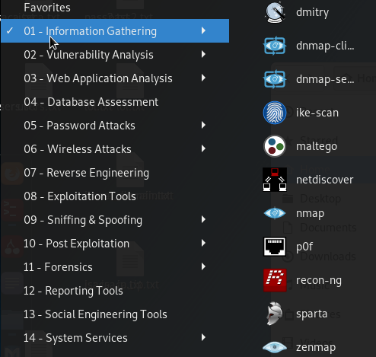
Toolkit
Many open source and proprietary tools exist to perform these various tasks.
Some are broad – collecting as much information as possible from multiple sources
Some are specific to a single type of data or data source
Local and web-based
At DGC, we leverage the Kali Linux operating system for most of these tasks
A purpose-built OS for penetration testing, security research, and hacking
Preinstalled open-source intelligence tools, as well as ongoing development and release of new tools.

Slide 6
Common External Tactics
External tactics are those which are conducted over the internet, and:
do not require a physical presence anywhere near your systems or personnel.
do not require logical access to your local network
are often a precursor to internal tactics
Open-Source Intelligence Gathering
2. Social Engineering
3. Compromised Credential Abuse

Slide 7
Open-Source Intelligence Gathering
Open-Source Intelligence (OSINT)
Information collected from the public domain (i.e. the internet)
About a business or organization:
Locations, clients, vendors, partners, financial data
About employees and users:
Organizational structure, names, emails, passwords
About technical infrastructure:
Internet facing systems and services
Wireless networks
Build a TARGET PROFILE

Slide 8
Open-Source Intelligence Gathering
Passive Intel Gathering
Methods of retrieving information by leveraging existing data, third-party services, etc.
Does not require actively engaging with a target system.
Active Intel Gathering
Methods of retrieving information by directly interacting with target systems.
Leaves a trace on target systems, can be illegal in some circumstances (i.e. geographical).

Slide 9
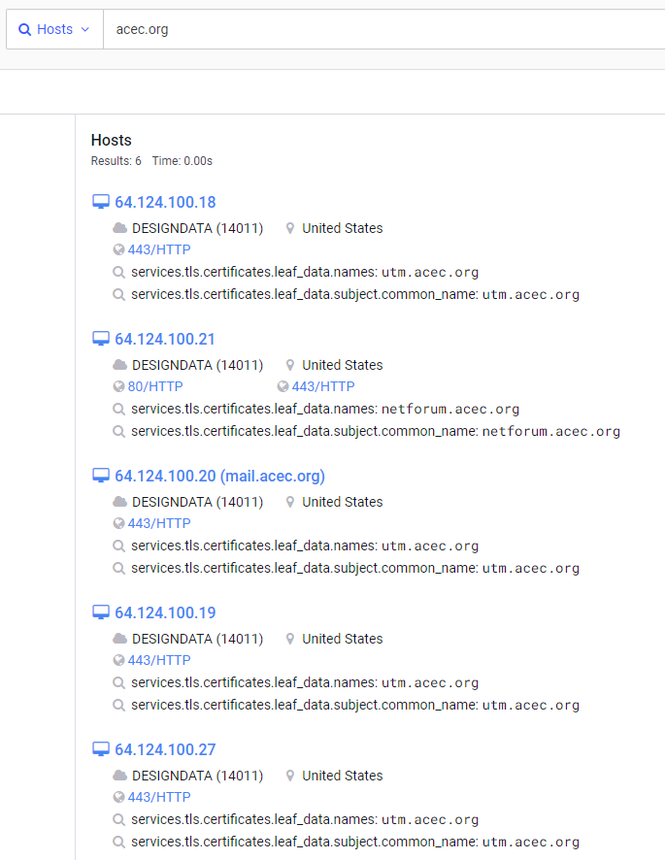
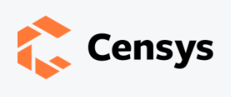
OSINT Tools
Free and publicly accessible IoT search engines. Used to search for devices rather than webpages.
Displays potentially useful information:
Public IP addresses
Location
Services/ports in use
SSL Certificate information
Used to quickly gain a technical understanding of internet facing systems without directly communicating with them

Slide 10
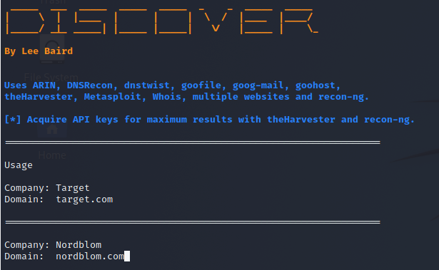
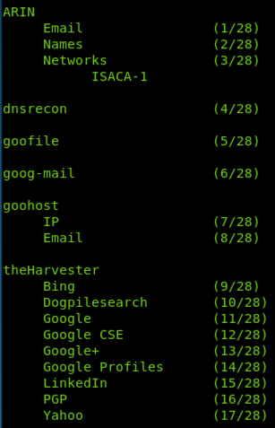
OSINT: Best Defense
Some of this information is meant to be public
Web servers & SSL certificates
Line of business applications
LinkedIn profiles.
It is important to understand that all data has value to an attacker.
Consider:
Social media privacy settings and training
Website security
inventory of internet-facing systems
Attack surface management
It’s critical to know what information your organization is making public
You can leverage the same TTPs we have demonstrated here.

Slide 11
Social Engineering
Phishing, phishing, phishing. Don’t click on links. Don’t open attachments. Phishing, phishing, phishing, phishing, phishing, phishing
Let’s see it from a different perspective – the hacker’s perspective…
Step 1: Clone Login Page
Identify a target with a login page from open-source intelligence gathering.
Use publicly available tools to create a copy of that webpage.
Step 2: Harvest Credentials
Modify the source code of the form to write data which is entered to a file.
Buy a lookalike domain.
Host the malicious landing page.
Step 3: Profit
Send some emails pretending to be from IT Support
Collect stolen credentials

Slide 12
Social Engineering: Best Defense
For end users
Never assume an email is from who it says it is from. It’s trivial to spoof names.
Never assume a website is what it says it is. It takes only a few clicks to clone a website.
Never assume a link in an email is taking you to where it says it is. Hover!
Always beware of emails that mention entering credentials, or links that bring you directly to a login screen.
For IT stakeholders
You should own all available top-level domains for your organization (i.e. com, org, net).
You should own common variations of your primary domain name.
You should provide training to your end users.
You should be phishing your users on a regular basis.
You should consider implementing perimeter controls to block requests based on domain age.
You must deploy multifactor authentication for all internet-facing resources

Slide 13
Compromised Credential Abuse
We can only control the information in our possession.
Consider it ”secure” if it’s on our server, in our datacenter, etc.
The most valuable information is the data that is not centrally managed.
What information is managed by your end users? To some extent:
Business sensitive information
Their usernames/email addresses
Their passwords
Because of this, you can’t prevent:
Use of work emails on external sites & services
Password sharing across multiple sites
TARGET THIS DATA

Slide 14
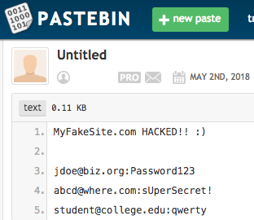
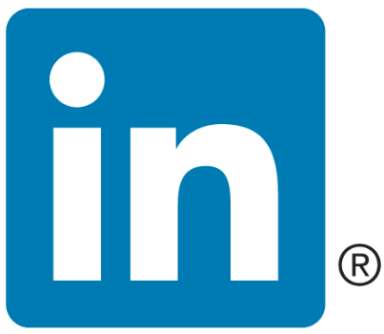
jdoe@biz.org
Password123
jdoe@biz.org
Password123

Slide 15
Compromised Credentials: Best Defense
We cannot completely prevent these “information leaks”, but we can take steps to reduce the likelihood of it occurring in the first place:
Train users never to reuse work passwords on external sites or services
Train users never to use work emails on external sites or services which are not work-related
We can also take steps to reduce the impact associated with leaked credentials:
Consider engaging in compromised credential monitoring to identify credentials which are exposed
Implement multifactor authentication to render compromised credentials (mostly) useless
If we decrease the likelihood, and we decrease the impact, then we have lowered the risk

Slide 16
Common Internal Tactics
Internal tactics are those which are executed locally, and:
May require physical access to individual information systems
Do require logical access to your local network
Legacy Name Resolution Protocol Abuse
Kerberos Abuse
Group Policy Preference File Abuse
Network Share Enumeration
Poor Password Hygiene Abuse
Physical Access Abuses

Slide 17
Legacy Name Resolution Protocol Abuse
This is a favorite among penetration testers and hackers alike.
Commonly the first step in gaining a foothold within a Windows environment.
Enabled by default, and NO ONE turns this stuff off.
DNS
Where is
\\filesrever\folder
LLMNR / NBT-NS
User
Query failed
Can anyone help me??
DNS Server
I can, it’s me! I’m filesrever and I am hosting folder
Connect to me!!!
Attacker

Slide 18
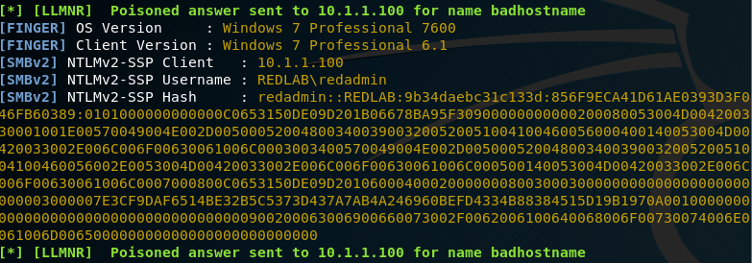
Legacy Name Resolution Protocol Abuse
Enter: Responder
This tool listens on the local network for multicast name resolution requests.
When it hears one, it “responds” to poison that request with a malicious response.
If it connects, responder requests authentication credentials.

Slide 19
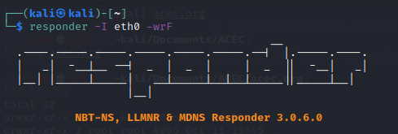
Best Defense
Now we have a NetNTLMv2 hash that we can either:
Attempt to crack to recover the plaintext password associated with the account
Relay to another system where that same user is a local administrator
How can you defend against this attack?
Disable Link Local Multicast Name Resolution via GPO
Disable NetBIOS Name Resolution via GPO
Password hygiene
Modern applications and Active Directory environments do not rely on these protocols, they rely on DNS!
Check it out on your own network:

Slide 20
Kerberos Abuse
Kerberos is an authentication protocol that is widely used within an Active Directory environment.
In general, it offers strong authentication for client/server applications using secret key cryptography.
However, certain features & weaknesses can be abused. For example…
Did you know that ANY authenticated user on your domain can request service account password hashes from the domain controller?
This is a pervasive attack technique that can be used to escalate privileges on a domain and facilitate lateral movement.
Kerberoasting

Slide 21
Kerberos Abuse
Enter: Impacket
This is a very powerful suite of protocol abuse tools. One component: GetUserSPNs is designed specifically to query Active Directory for service account hashes:
Service accounts supporting applications running at the domain-level (i.e. supporting domain authentication) are vulnerable to this attack

Slide 22
Best Defense
Now we have a Kerberos ticket which is encrypted with the affected user’s password. We can crack this material offline to recover the plaintext password associated with the account.
This is very valuable, because these service accounts are most often linked to administrative accounts on the domain.
This attack cannot be “fixed”… only mitigated
How can you defend against this attack?
Password Hygiene
Advanced Active Directory monitoring (EDR)
Check it out on your own network:

Slide 23
Group Policy Preferences File Abuse
We all know Group Policy: it’s a mechanism for deploying and enforcing configurations on Windows systems throughout a domain.
When a domain-joined machine connects to the network, it checks for any new or modified group policies by querying the Active Directory domain controller.
Group Policy Preferences were introduced in Windows Server 2008 and extends GPO functionality to include a bunch of stuff…including management of local user accounts.

Slide 24
Group Policy Preferences File Abuse
A common use case is using Group Policy Preferences to manage local administrator passwords (or other local account passwords) across an Active Directory Domain.
Microsoft was gracious enough to encrypt that password, so that it cannot be read or abused by malicious users.
Then, in 2012, they published the decryption key! Since then, no passwords stored in GPP have been safe.

Slide 25
Best Defense
Remember, Active Directory is readable by all authenticated users on the domain, so anyone can search for and abuse these stored credentials.
How can you defend against this attack?
Don’t store any credentials in GPP files, at all.
Don’t use the same local administrator password across all your hosts (for LOTS of reasons)
Consider leveraging the Local Admin Password Solution (LAPS) to securely manage local administrator passwords.
Check it out on your own network:
- Identify stored credentials:
- Decrypt stored credentials:

Slide 26
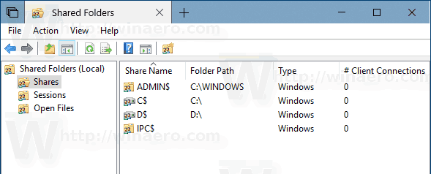
Network Share Enumeration
Network share enumeration is a powerful mechanism to obtain valuable information, as many organization host their “crown jewels” on file servers.
A common attack technique is to identify “open” shares, that is, shares that are either:
Accessible without any authentication (very bad)
Accessible using the current compromised user account (not inherently bad)
Over time, network share permissions tend to become broader and broader
Configuration drift
Users may also be exporting network shares on their local systems without even knowing it.

Slide 27
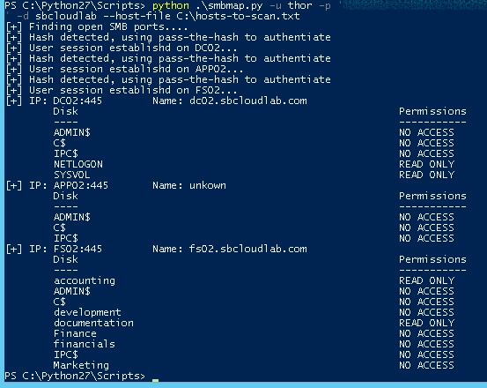
Network Share Enumeration
Enter: SMBMap
A handy tool to enumerate and search available SMB shares across a network.
Common findings:
Standard (compromised) user account has broad access to sensitive company information. Organizations rarely adhere to the “principle of least privilege”.
Misconfigured network shares expose web application source code, database connection strings, configuration files, and other information that is valuable for privilege escalation.
Standard users with local administrator access are sharing locally hosted folders because it allowed them to “get around” a permissions issue.

Slide 28
Best Defense
In this case, there is no way around “doing the work”.
You need to understand what people require access to, and then build role-based access controls around those requirements.
This will limit the exposure of sensitive data as a result of any one compromised user account.
Manage access to network shares based on group membership.
Check it out on your own network:
Create a host list:
Scan those hosts with smbmap:
Try it with and without credentials!

Slide 29
Poor Password Hygiene Abuse
Nearly all of the attack tactics we have demonstrated so far involve user credentials in one form or another.
Sometimes, we leverages weaknesses to recover hashed passwords that we then need to crack.
But what if we can just guess passwords, without having to do any heavy lifting at all.
BUT WAIT! That sounds like a brute force attack. My account lockout settings protect me from brute force attacks!
Enter: Password Spraying

Slide 30
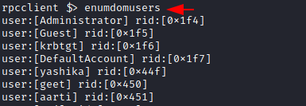
Poor Password Hygiene Abuse
Password Spraying: Instead of trying to hit ONE user account with MANY passwords
Try hitting MANY user accounts with ONE password
This avoids account lockouts, and is often very successful in recovering additional user accounts during a penetration test.
What we need: a list of Active Directory user accounts.
1. This can be obtained by any authenticated user on the domain
2. This can be obtained by any unauthenticated user if NULL sessions are enabled
Check it out on your own network:
NULL Session attempt:
Dump domain users:
This should FAIL without credentials

Slide 31
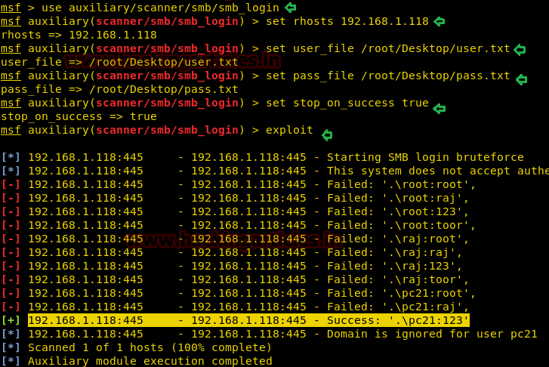
Poor Password Hygiene Abuse
TRY IT!
Once we have a list of Active Directory user accounts, we can attempt to authenticate to each one using a few very common (and bad) passwords.
Examples:
Password1!
Summer2021!
These passwords meet an 8-character minimum length / complexity requirement but are very weak!
Now, spray the network with these bad passwords to compromise additional accounts.

Slide 32
Best Defense
Password hygiene is, unfortunately, very important in the modern enterprise.
Passwords are not the best way to secure a user account, but we are stuck with them, especially internally.
Strong, complex passwords across an organization will help to prevent most of the attacks we have shown here from being successful.
Best practices:
Establish standards via policy, and train your users
14 characters or longer
No dictionary words
Introduce pass phrases
Use a password manager
MULTIFACTOR AUTHENTICATION

Slide 33
Physical Access Abuses
Next step: time to actually go onsite. Depending on the engagement, we might be granted access… if not… let’s GET access.
RFID = Radio Frequency Identification. Key cards, fobs, tags = physical access controls.
ProxMark = dedicated hardware to read and write to RFID chips.
If I can get close enough, we can read your key card. Then I can write that to a new card and become YOU.

Slide 34
Best Defense
Protect your badge. It’s part of your identity.
Keep your badge on your person, take it off and store securely when you leave work.
Guards can help…if they can match up a scanned card with a photo ID.
Watch out for tailgating – people trying to get past physical access controls by tagging along with someone else.
Encryption - less than 20% of organizations have embraced the new generation of RFID technology which prevents these attacks via encrypted traffic.

Slide 35
Physical Access Abuses
Now that we are in, find an open Ethernet port, unplug an IP phone, or connect to the wireless network, and start the entire information gathering and exploitation process again, this time, internally.
OR, we can leverage our physical access for some hardware-based attacks.
Port Scan
Vulnerability Scan
Exploit
Identify target systems

Slide 36
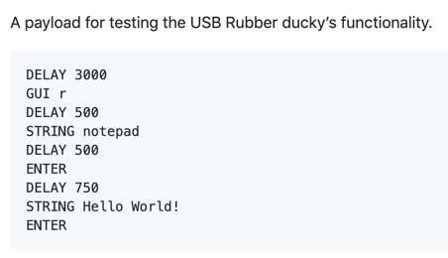
Physical Access Abuses – Rubber Ducky
NOT!
It’s a USB stick!
When plugged into a machine, its actually recognized as a keyboard
Program certain keystrokes which do bad things on target systems.
Easily programmable in “Ducky Script”

Slide 37
Physical Access Abuses – LAN Turtle
It’s a USB network adapter!
Remote Access Tool / Backdoor … plug it into the wall and find an open Ethernet port. Leave it behind.
Auto connect back to an attacker controlled system.
Provides remote access and network intel gathering
Or – put it in line behind someone’s machine
Provides man-in-the-middle and packet capture surveillance
Or – on Windows systems, exploit inherent trust of network devices, and pull user passwords off of LOCKED MACHINES
NOT!

Slide 38
Best Defense
Never assume a USB drive is clean.
Never assume a USB drive is… a USB drive.
Never insert unknown USB drives or other portable storage devices.
As an organization, publish policies around the use of USB drives.
As an organization, enforce technical controls and restrictions on the use of USB drives.

Slide 39
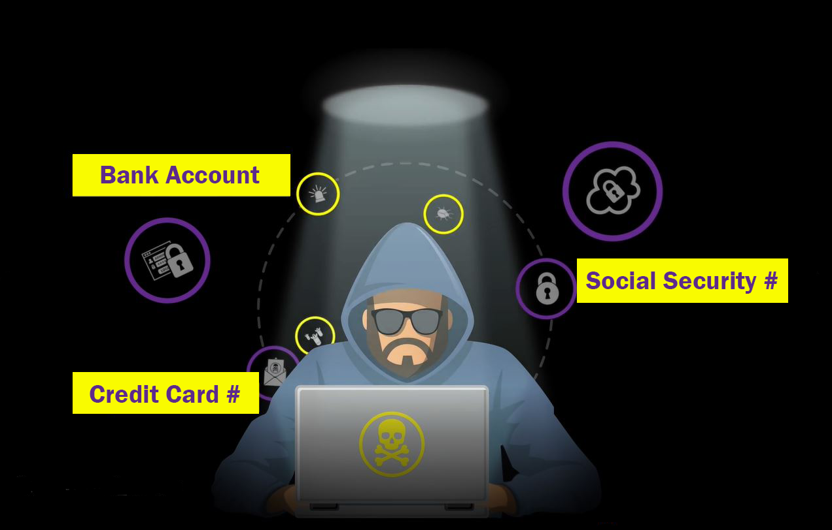
Risks Realized
What can a hacker do with all this data?
GAIN A FOOTHOLD
Send spam from compromised email accounts
Compromise other accounts via the same credentials
Deface websites and host malicious content
Install malware on accessible systems
Exfiltrate sensitive data
Identity theft

Slide 40
QUESTIONS?

