Slide 1
Resilient to Change The DCR Perspective
Jeffrey R. Parenti, PE, PTOE, PTP, ENV SP
ACEC/MA
Climate Resiliency and Risk Management Update
September 18, 2019

Slide 2
About the DCR
Statewide Parks Agency
Assets in 300 Cities and Towns
About 500,000 acres
Natural, vertical, and horizontal assets
Buildings
Dams
Beaches, swimming pools, skating rinks
Cultural Resources
Parks, forests, playgrounds
Parkways

Slide 3
DCR Mission Statement
To protect, promote and enhance our common wealth of natural, cultural and recreational resources for the well-being of all.

Slide 4
Executive Order 569
“Combatting and preparing for the impacts of climate change will require a holistic approach across state and local government and collaboration with stakeholders from all corners of the Commonwealth”
(Governor Baker, September 2016)

Slide 5
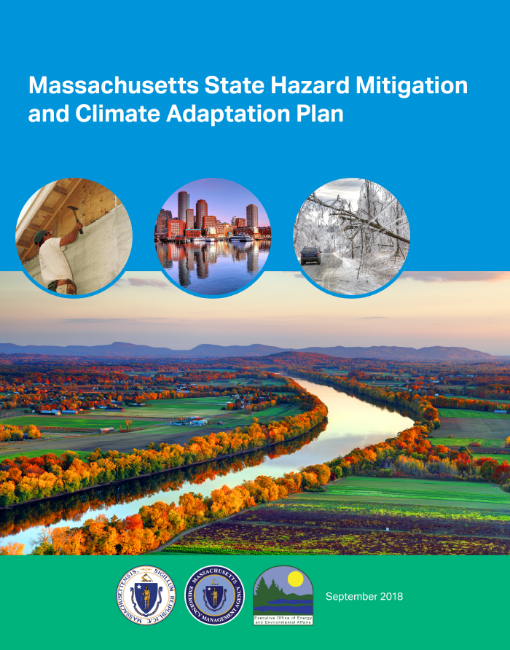
DCR is either a lead or a partner in 11 actions

Slide 6
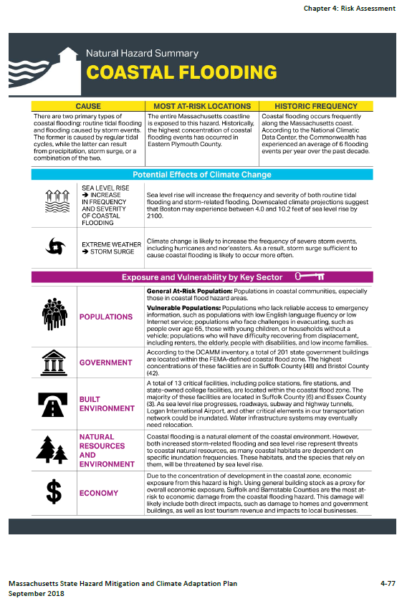

Slide 7
Risks and DCR Assets
Inland Flooding
Drought
Landslide
Coastal Flooding
Coastal Erosion
Tsunami
Average and Extreme Temperature
Wildfire
Invasive Species
Hurricanes/Tropical Storms
Severe Winter Storm/Nor’Easter
Tornadoes
Earthquakes
Other Severe Weather

Slide 8
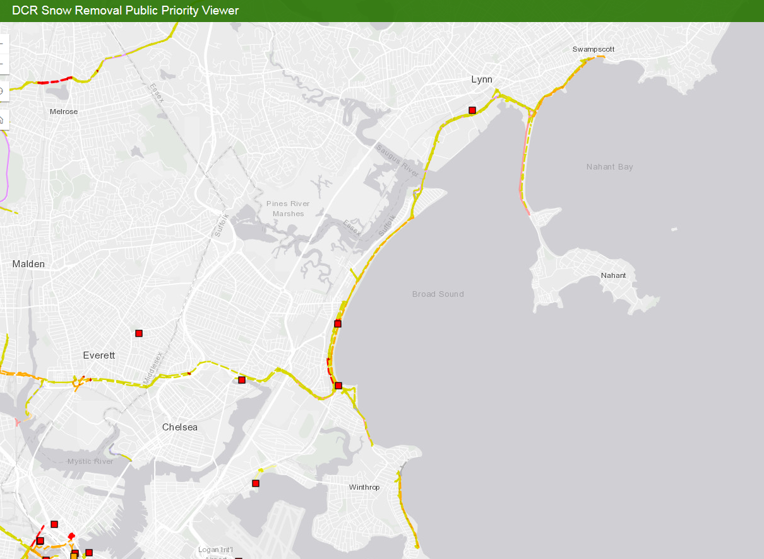

Slide 9
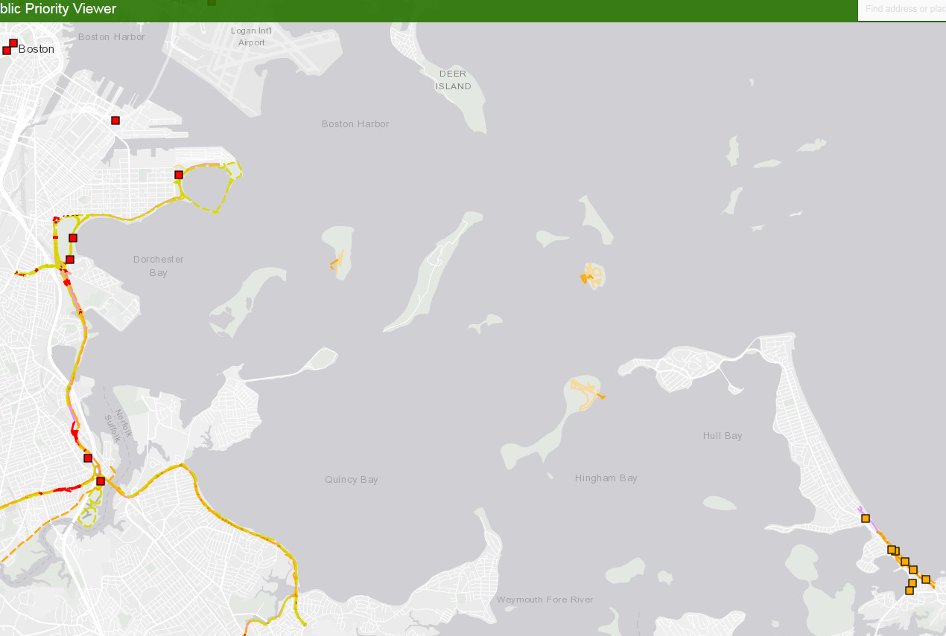

Slide 10
DCR Climate Action
In January, 2019, the agency kicked off its implementation effort in a meeting with senior managers and program leaders from across and formed four working groups.
Design Standards
Forest Action Plan
Communications
Planning/Data Collection

Slide 11
DCR Climate Action
Leadership Academy in April 2019
DCR rolled out the four working groups to the staff with presentations about actions to date and an invitation to offer ideas and input.
DCR wants everyone to understand the predicted effects of climate change. We also gave all staff a Toolkit on Climate Change with the Executive Summary and DCR’s actions
Keynote speaker Dr. Renee Salas spoke about the connection between climate change and health.

Slide 12
DCR Climate Action
Leadership Academy in April 2019
DCR rolled out the four working groups to the staff with presentations about actions to date and an invitation to offer ideas and input.
DCR wants everyone to understand the predicted effects of climate change. We also gave all staff a Toolkit on Climate Change with the Executive Summary and DCR’s actions
Keynote speaker Dr. Renee Salas spoke about the connection between climate change and health.

Slide 13
Working Group Progress
Design Standards is working on developing design principles to help guide the agency’s design decisions
Forest Action Plan is addressing climate change in the update to DCR’s plan (updates are required every 10 years to the US Forest Service)

Slide 14
Working Group Progress
Communications
Developed a dictionary of climate change words for staff to be conversant with climate changer terms as well as potential conditions and proposed solutions
Issued climate change themed backpacks to parks for visitors to check out and use during their park visit. The pack contains books and materials to introduce simple concepts to explain climate change
Developing junior ranger book with climate change theme

Slide 15
Working Group Progress
Planning/Data Collection
Developing a scope to complete a pilot vulnerability study of one DCR property which would assess the current assets (buildings, cultural resources, forests, etc.) and overlay the proposed conditions (increased temperature, increased rainfall, etc.) to determine the vulnerability of assets.
Help the agency make decisions about how to safeguard the assets through mitigation and adaptation where possible. The idea is to use the pilot to develop a methodology that can be used statewide.
Factor into our decision-making about prioritizing projects to fund in DCR’s large portfolio.

Slide 16
Discussion
Jeffrey R. Parenti, PE, PTOE, PTP, ENV SP
Deputy Chief Engineer
jeffrey.parenti@mass.gov
617.626.1499
mass.gov/dcr

