Slide 1
Climate Change & the Commonwealth
Mia Mansfield,
Director of Climate Adaptation and Resilience
MA Executive Office of Energy and Environmental Affairs
Notes:
Thank you to our hosts!

Slide 2
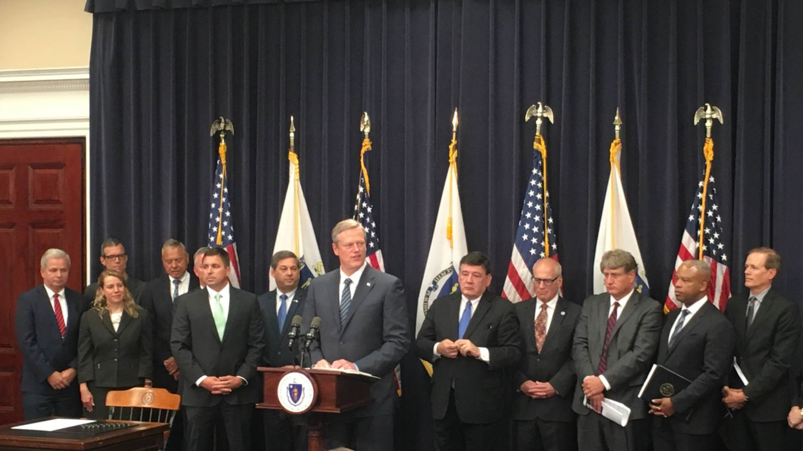
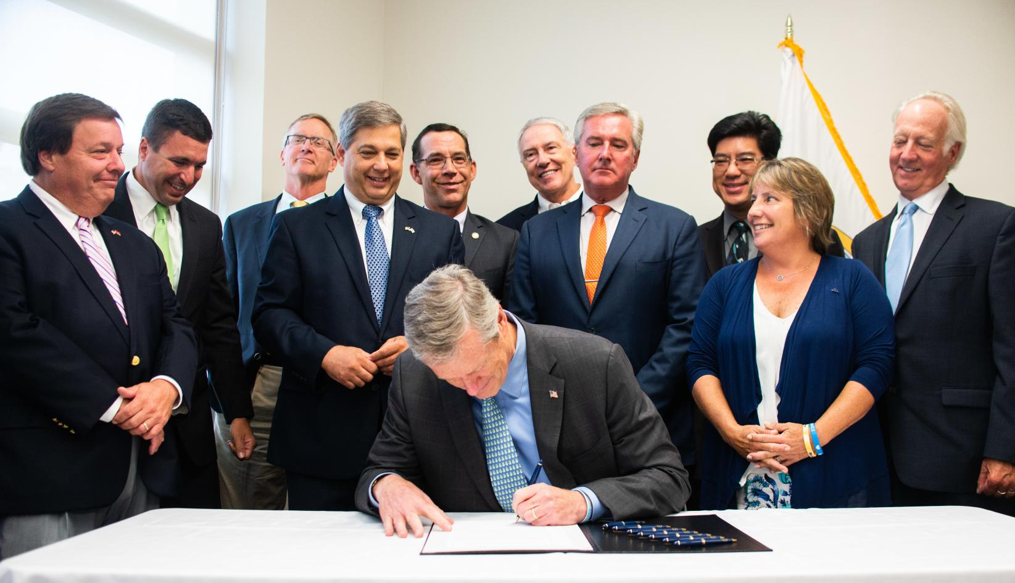
Executive Order 569 - 2016
Environmental Bond - 2018
Comprehensive approach to reduce GHG emissions to combat climate change and prepare for the impacts of climate change
State Adaptation Plan
Climate Coordinators
Agency Vulnerability Assessments
Municipal Support
$2.4 billion bond bill with focus on climate change resiliency
Over $200 million authorized for climate change adaptation
Codifies EO 569, including the MVP Program

Slide 3
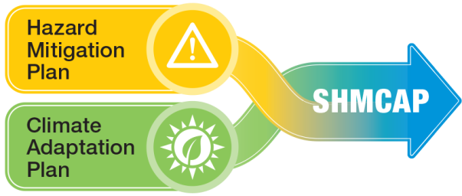
Massachusetts State Hazard Mitigation and Climate Adaptation Plan (SHMCAP) - September 2018
Acknowledges that climate change is already worsening natural hazards, integrating information and planning elements for 14 natural hazards that affect the Commonwealth
Uses best scientific data and projections to assess risk and vulnerability
Evaluates the Commonwealth’s existing capabilities to implement agency-specific and statewide activities to reduce risk and increase resilience
Notes:
First-of-its-Kind Integrated State Plan

Slide 4
SHMCAP Key Risk Assessment Findings and Actions
14 hazards
Over $9.1M in damages/year,
2007-2014
Inland flooding
Drought
108 actions,
including:
Landslide
Coastal flooding
On average, 6 events/ year, 2009-2018
Coastal erosion
Tsunami
Develop climate change design standards
Maintain and enhance climate change projections
Incorporate climate effects into capital planning functions
Create MA Coastal Flood Risk Model
Extreme temperatures
Wildfire
Invasive species
Hurricanes/ Tropical storms
Severe winter storms / Nor’easters
200+ critical facilities in tornado hazard zones
Tornadoes
Other severe weather
Earthquakes
Notes:
First-of-its-Kind Integrated State Plan

Slide 5
SHMCAP
SHMCAP Implementation
Leading by example
ResilientMA Action Team (RMAT)
State and local partnerships
Municipal Vulnerability Preparedness Program (MVP)
Notes:
First-of-its-Kind Integrated State Plan

Slide 6
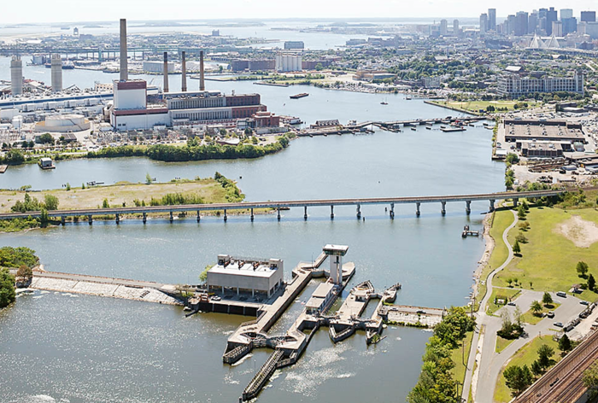
RMAT: Resilient MA Action Team
Responsible for the State Hazard Mitigation and Climate Adaptation Plan (SHMCAP) implementation, monitoring, and maintenance, with representatives from each Secretariat and key state agencies
RMAT Technical Advisor (Aug 2019-2021)
First year initiatives
Statewide resilience standards and guidance
Resilient capital planning evaluation tool
Action tracker
+ Templates for municipalities

Slide 7
Municipal Vulnerability Preparedness (MVP) Program
A state and local partnership to build resilience to climate change by building capacity to respond to climate effects at the local level and pilot innovative adaptation practice
Across the Commonwealth, cities and towns need financial and technical resources to prepare their residents, businesses, and aging infrastructure:
300 high-hazard dams
12,000+ culverts and small bridges needing replacement
1,100 municipally-owned coastal structures

Slide 8
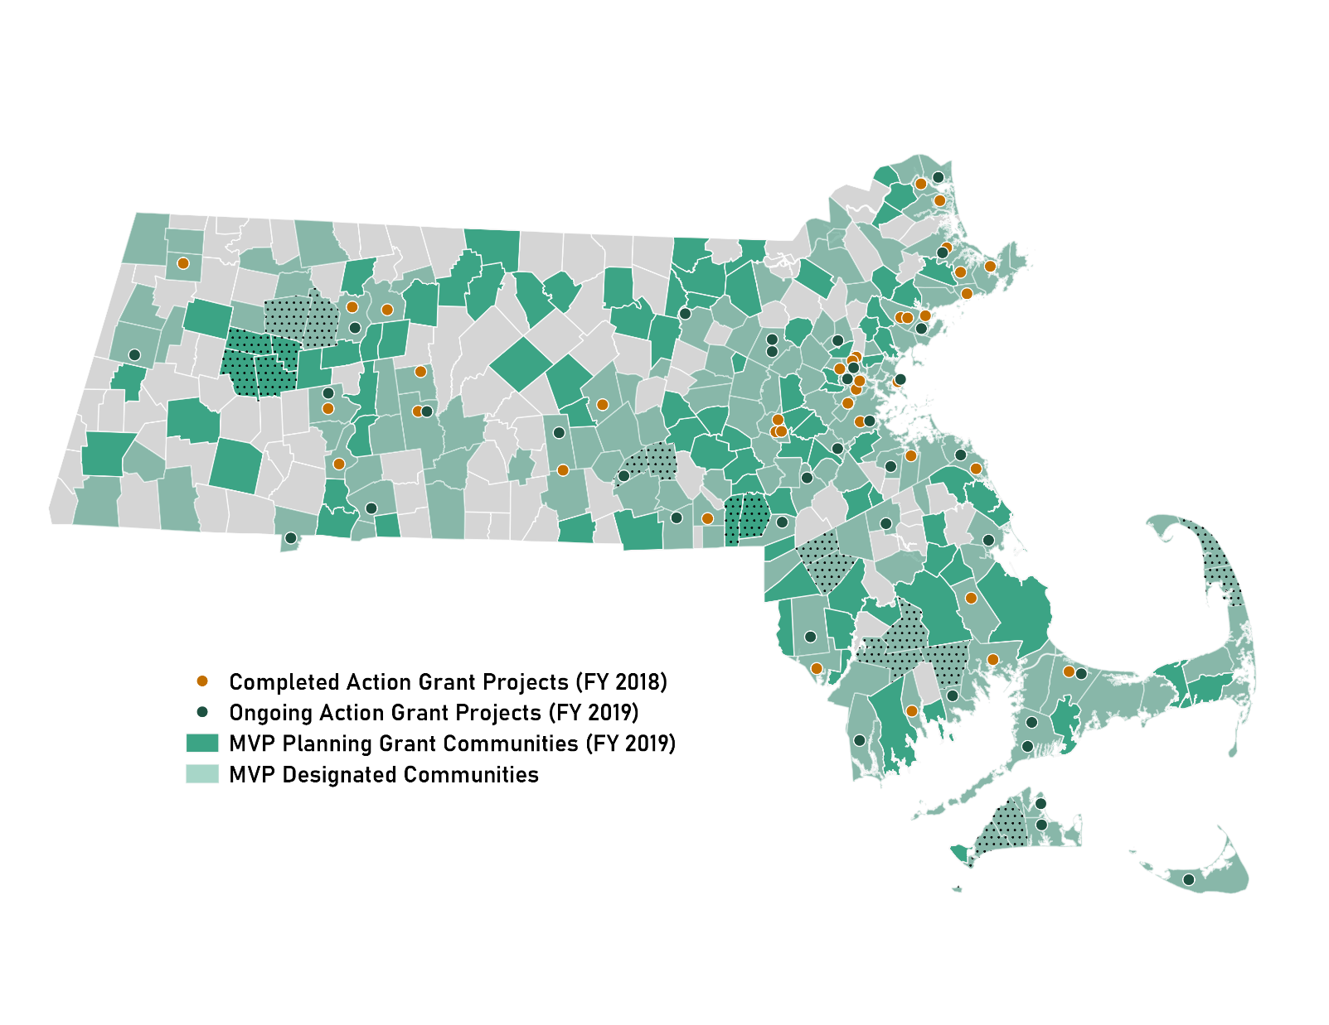
Three Years of MVP
MVP Designations 71% of the Commonwealth 249 communities
Action Grant Projects FY 18: 37
FY 19: 36
FY 20: Released Sept. 2019
Total Awards $17M+ in planning and action grants to date

Slide 9
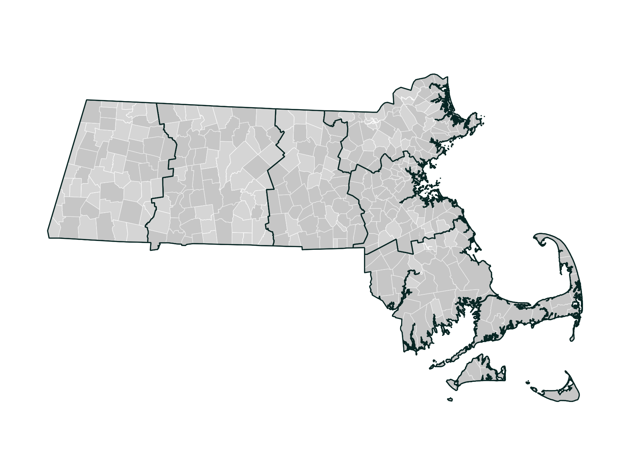
MVP Regions
Regional Coordinator:
(to be filled) – DEP Springfield
Northeast
Regional Coordinator:
Michelle Rowden – DEP Lawrence
michelle.rowden@mass.gov
Greater CT River Valley
Berkshires & Hilltowns
Greater Boston
Regional Coordinator:
Carolyn Meklenburg – EEA Boston
carolyn.meklenburg@mass.gov
Central
Regional Coordinator:
(to be filled) - DEP Pittsfield
Regional Coordinator:
(to be filled) – DEP Worcester
Southeast
Regional Coordinator:
Courtney Rocha – DEP Lakeville
courtney.rocha@mass.gov

Slide 10
MVP Principles
A community-led, accessible process that
Employs local knowledge and buy-in
Utilizes partnerships and leverages existing efforts
Is based in best available climate projections and data
Incorporates principles of nature-based solutions
Demonstrates pilot potential and is proactive
Reaches and responds to risks faced by EJ communities and vulnerable populations
Why nature-based?
Where appropriate, nature-based solutions can be more cost-effective, protect water quality and quantity, sustain lands that provide food and recreation opportunities, reduce erosion, and minimize temperature increases associated with developed areas and climate change.
Notes:
Mainstreams climate change
Addresses social equity and climate threats faced by the socially vulnerable and environmental justice communities

Slide 11
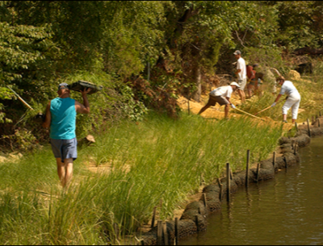
MVP Grants
MVP Planning Grant: Coming Sept 2019
$15,000- $100,000 per plan, completed by 6/30/2020
Some expanded scopes
$1M available
MVP Action Grant: Coming Sept 2019
Open to MVP communities
$25,000- $2M per project, completed by 6/30/2020
$10M available
https://www.mass.gov/municipal-vulnerability-preparedness-mvp-program
Notes:
What about a “resources” page – also includes ResilientMA, …

Slide 12
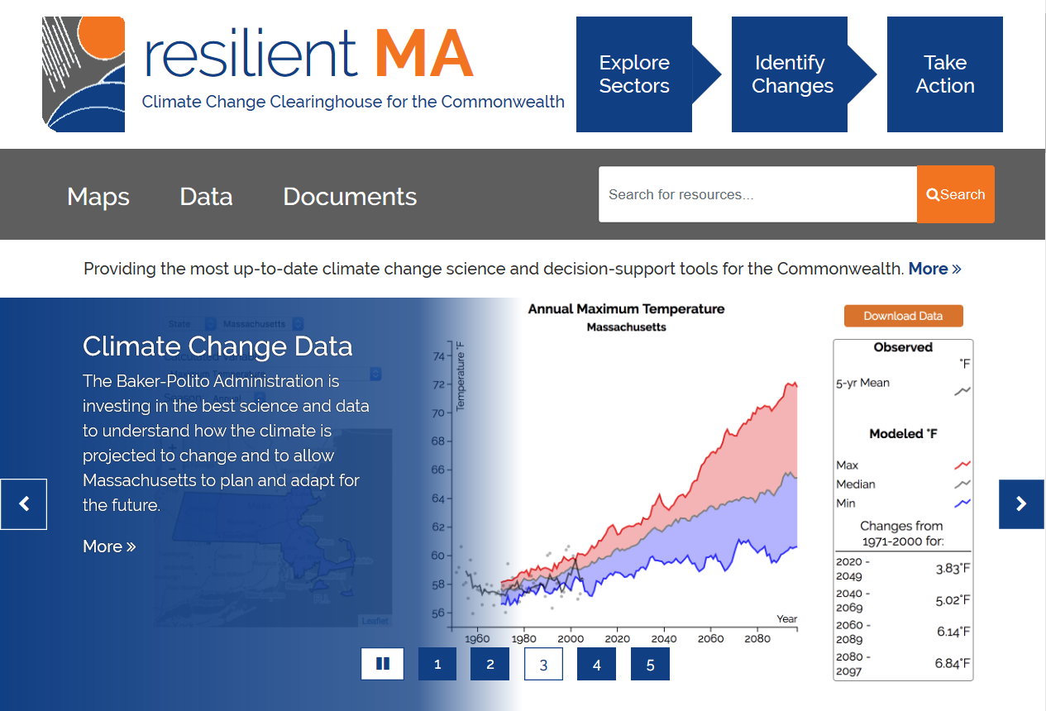
MVP Resources
https://www.mass.go/municipal-vulnerability-preparedness-mvp-program
Notes:
What about a “resources” page – also includes ResilientMA, …

Slide 13
MVP: What we’re hearing - 2018 & 2019 MVP Planning Reports
Top Hazards
1
1
Inland flooding
Extreme precipitation and precipitation-induced flooding, ice jams, dam failures
2
3
2
Severe winter storms
Snow/Ice storms, Nor'easters
3
Average/ Extreme temperatures
Extreme heat, extreme
cold, average higher temperatures

Slide 14
Municipal Priorities
MVP: What we’re hearing - 2018 & 2019 MVP Planning Reports
Emergency management and preparedness
Top Priority Actions
3
1
Regulations, zoning, and policy
2
Data and maps
1
Vulnerable populations
3
Stormwater management
Top Vulnerabilities
2
Roadways

Slide 15
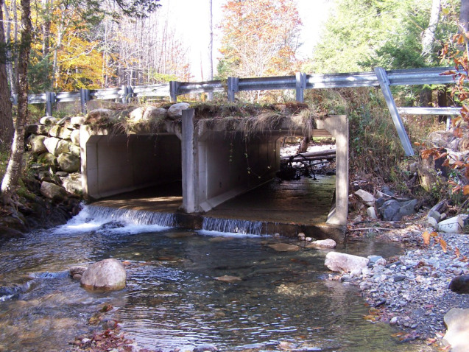
MVP Action Grants: Project Types
Detailed Vulnerability and Risk Assessment*
Community Outreach and Education
Local Bylaws, Ordinances, Plans, and Other Management Measures**
Redesigns and Retrofits***
Nature-Based Flood Protection, Drought Prevention, Water Quality, and Water Infiltration Techniques
Nature-Based, Infrastructure and Technology Solutions to Reduce Vulnerability to Extreme Heat and Poor Air Quality
* Most common project type
** Second-most common project type
***Third-most common project type
Notes:
Climate Resilience Policy Audit/Amendments, LID & Design Guidelines (Town of Brookline)
Sawmill Brook Central Pond Restoration Design (Town of Manchester)
Feasibility Study for an Essex Bay Living Shoreline (Town of Essex)
Tree Planting Plan to Mitigate Heat Islands and Reduce Runoff (Town of Natick)
Water/Sewer Infrastructure Green Emergency Power Study (Town of Holden)

Slide 16
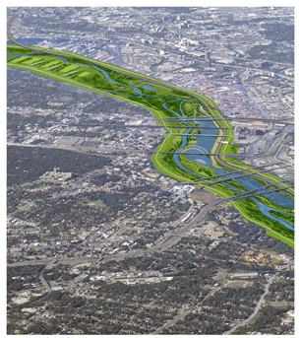
MVP Action Grants: Project Types (cont.)
Nature-Based Solutions to Reduce Vulnerability to other Climate Change Impacts
Ecological Restoration and Habitat Management to Increase Resiliency
NEW IN 2019
Energy Resilience
Chemical Safety
Land Acquisition for Resilience
Mosquito Control Districts
+ Expanded eligibility of project location
Notes:
OTHER: other impacts of climate change such as extreme weather, damaging wind and power outages, increased incidence of pests and vector-borne illnesses and other public health issues, and increases in forest pests
Ecological restoration: repair or improve degraded natural resources within a municipality to enhance resilience and adapt to climate change, such as right-sizing culverts, dam removal, controlled burns, soil stabilization
Energy resilience: incorporate clean energy and be paired with resilience enabling technologies such as energy storage, energy management systems, blackstart and islanding technology, and microgrids
Chemical safety: engage the business and manufacturing community on identifying vulnerabilities to chemical releases due to severe weather events, reducing use of toxic or hazardous chemicals, improving operations and maintenance procedures to prevent chemical releases and accidents, improving emergency and contingency planning, and/or identifying existing contaminated sites that pose chemical dispersion risks during flood events are eligible.
Land acquisition: if the parcel has been identified through a climate vulnerability assessment as an appropriate location for a specific eligible adaptation activity to occur

Slide 17
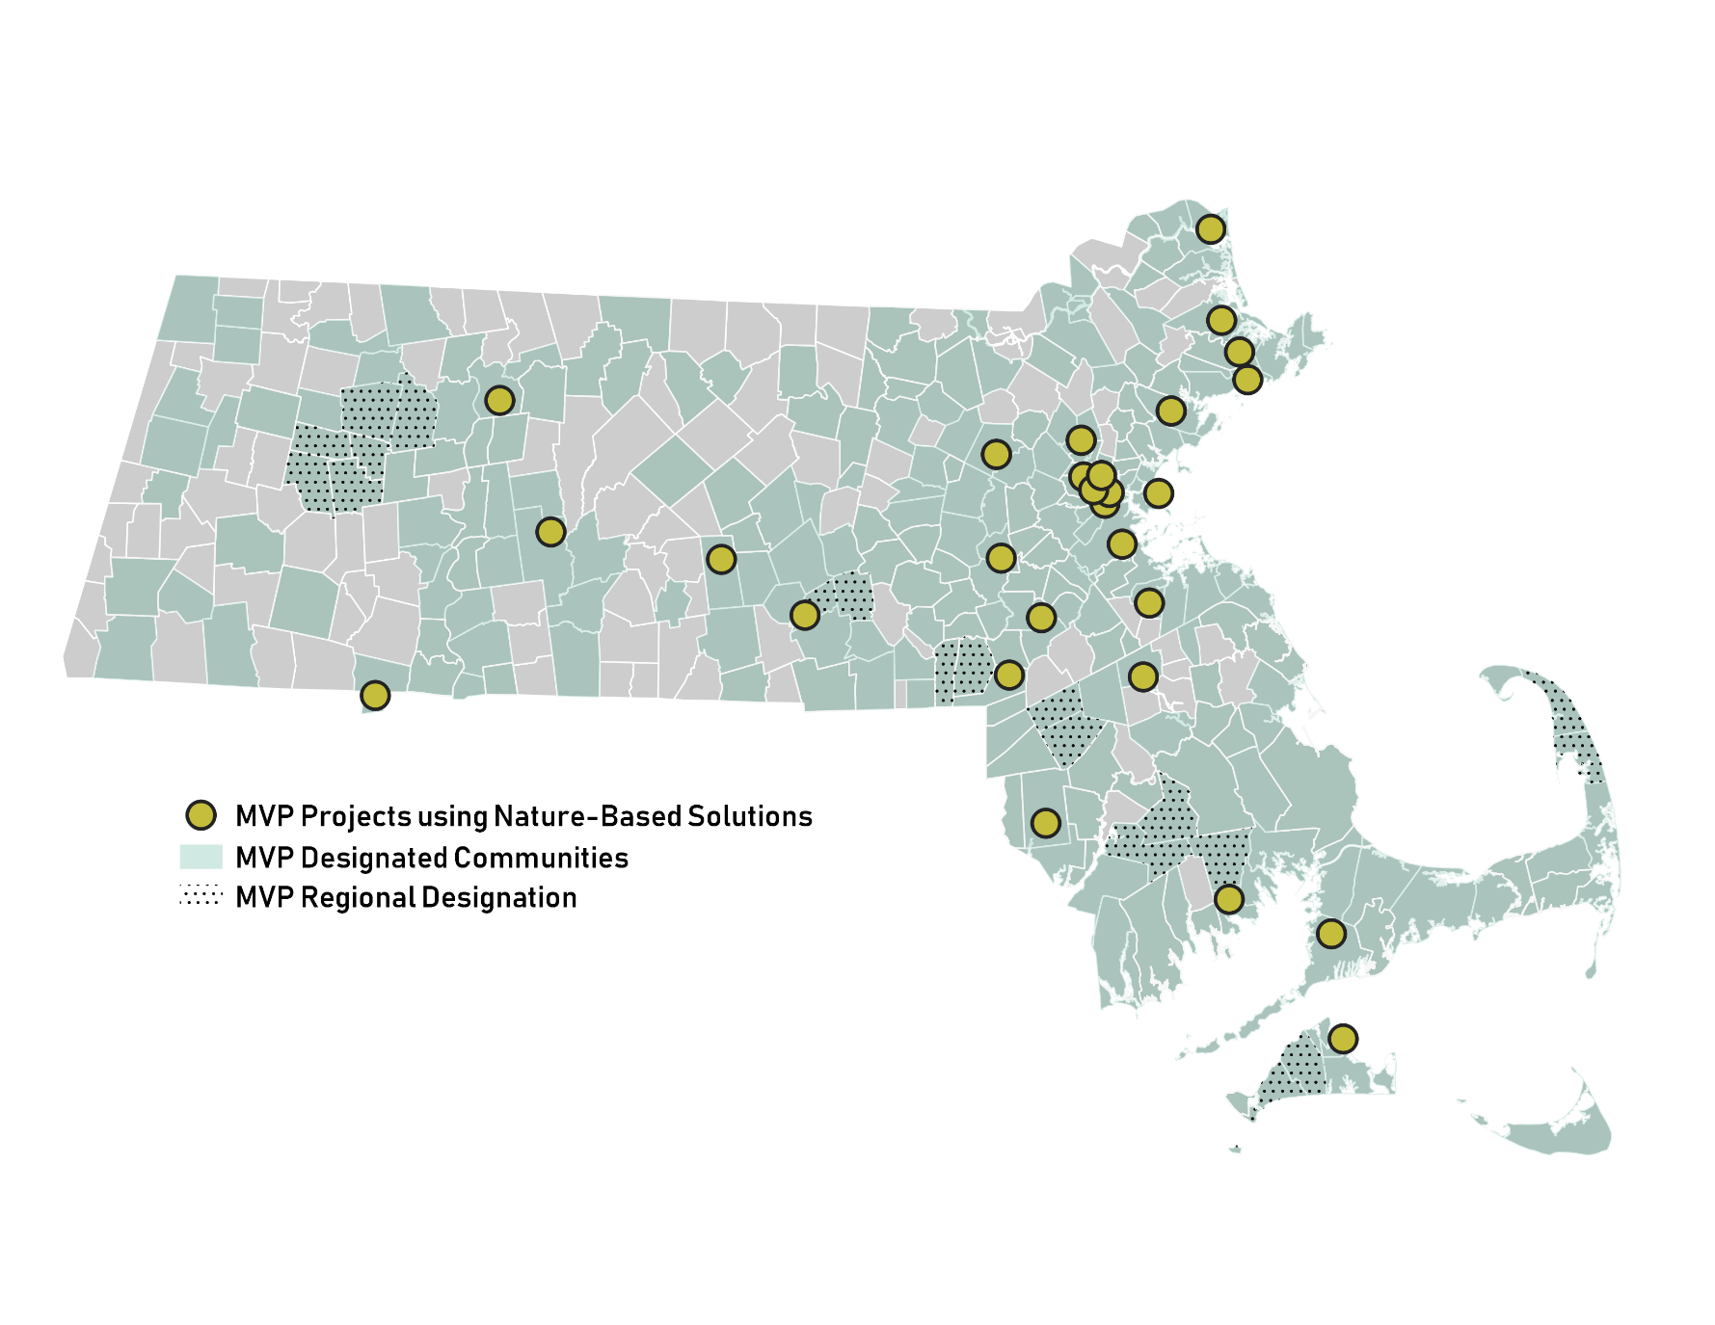
Nature-Based Solutions
Essex, Ipswich, Newbury (Regional)
Sedimentation study
Concord
Reforestation and municipal tree resilience
Southwick
Stream crossing replacement with upstream nature-based flood mitigation measures
Millbury
Green infrastructure in downtown revitalization
Northampton
Detaining, retaining, treating stormwater with green infrastructure
Falmouth
River restoration
Oak Bluffs
Beach nourishment
MVP Planning Grant/Designated Communities (2017-2019)
Notes:
As I mentioned before, nature-based solutions are a cornerstone of the MVP program. We have funded different types of nature-based solutions all throughout the sate, some of which are displayed here.
Nature-based solutions rely on ecological processes to achieve climate resilience objectives. They use natural systems, mimic natural processes, or work in tandem with traditional approaches to address natural hazards like flooding, erosion, drought, and heat islands
Nature-based climate adaptation solutions include various types of green infrastructure, open space preservation, and low-impact development practices. Options include:
Wetlands conservation
Raingardens and bioswales to capture stormwater, recharge aquifers, and improve water quality
Tree-planting to improve air quality and mitigate urban heat islands
Land acquisition to conserve habitat and limit development in risky areas like floodplains
Daylighting streams to mitigate flooding and turn waterways into scenic community assets
Dam removal to remove deteriorating infrastructure and restore riverine ecosystems
Bylaw review to encourage Low-Impact Development (LID) and encourage open space preservation

Slide 18
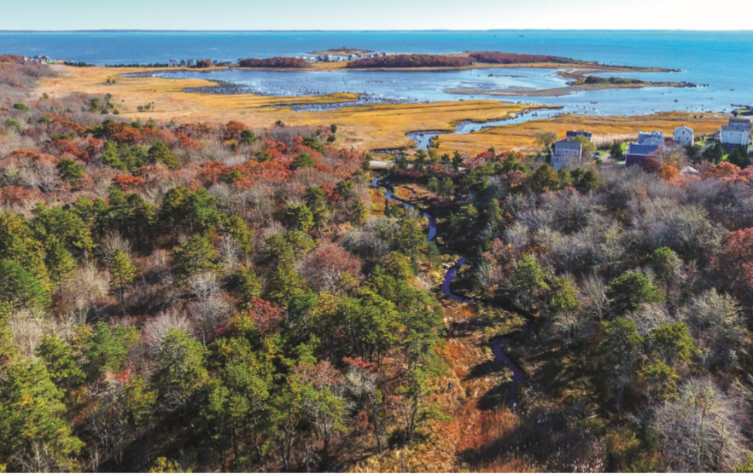
Example Action Grant Projects
Mattapoisett
PROJECT TYPE: Land Acquisition for Resilience
Purchased 120 acres of forest, streams, freshwater wetlands and coastal salt marsh as conservation land to prevent development in vulnerable areas
Data utilization
Proactive

Slide 19
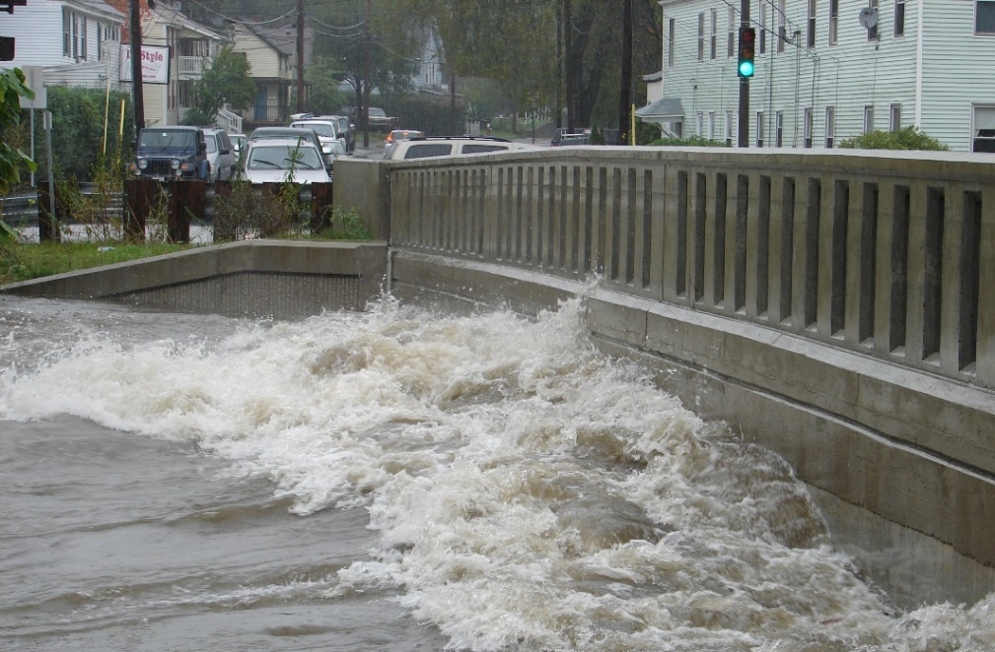
Example Action Grant Projects
Millbury
PROJECT TYPE: Nature-Based Flood Protection, Drought Prevention, Water Quality, and Water Infiltration Techniques
Utilizing green infrastructure like stormwater planters, bioretention bump outs, rain gardens, and other measures like porous pavers and pervious pavement to reduce heat island effects and stormwater runoff into the Blackstone River.
Nature-based solutions

Slide 20
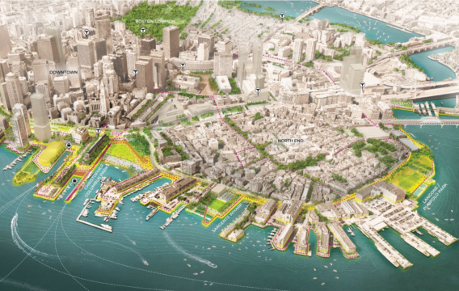
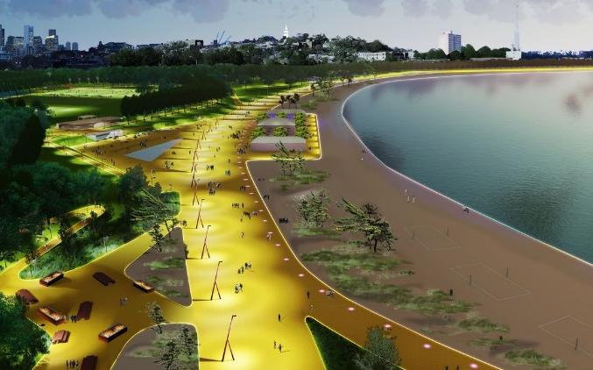
Example Action Grant Projects
Boston
PROJECT TYPE: Local Bylaws, Ordinances, Plans, and Other Management Measures
PROJECT TYPE: Redesigns and Retrofits
Developing its first ever resilient building code so that development in the future floodplain is prepared for at least three feet of sea level rise, the likely scenario by late century.
Retrofitting a major waterfront park into a legacy park that uses nature-based solutions to address climate vulnerabilities while providing important access to recreation for residents.
Proactive
Nature-based solutions
Pilot potential
Community co-benefits

Slide 21
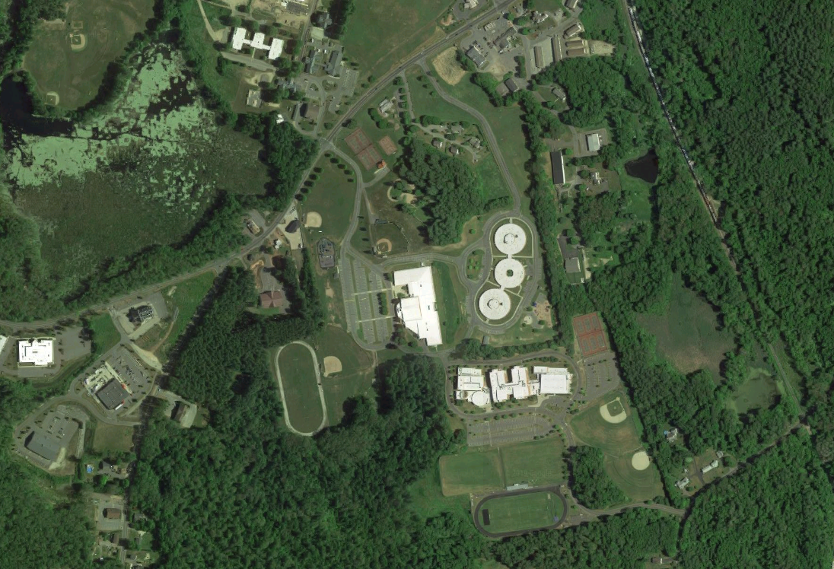
Example Action Grant Projects
Belchertown
PROJECT TYPE: Nature-Based Flood Protection, Drought Prevention, Water Quality, and Water Infiltration Techniques
Designing and permitting for a replacement water storage tank that would increase storage capacity and resiliency to drought, and completing a feasibility/ concept design of a rainwater harvesting system at Belchertown High School to irrigate the athletic fields.
Nature-based solutions
Pilot potential

Slide 22
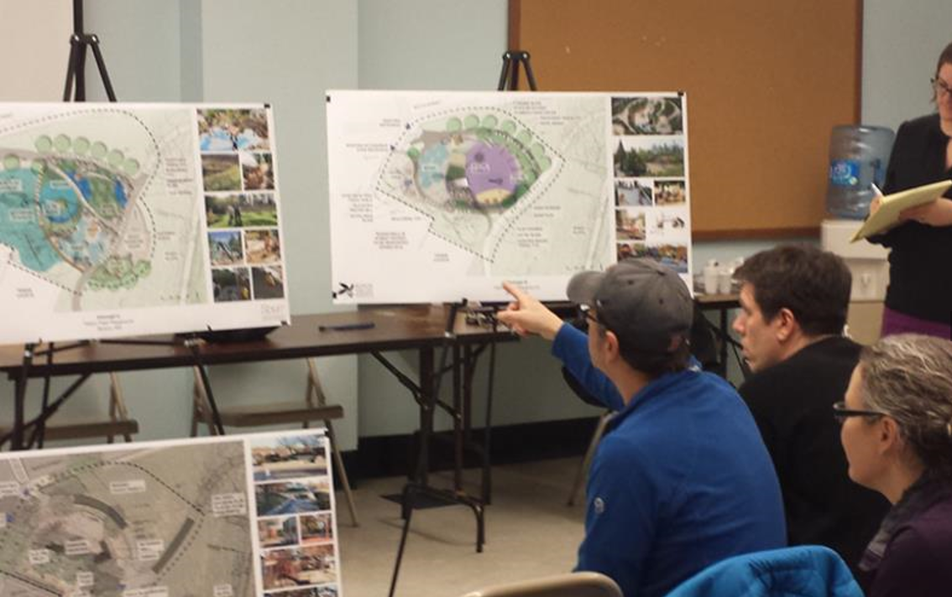
Example Action Grant Projects
Salisbury
PROJECT TYPE: Redesigns and Retrofits
Increasing the resilience of the neighborhood of Ring’s Island by raising its access/egress roads and by improving tidal flushing through culvert replacements
Vulnerable communities

Slide 23
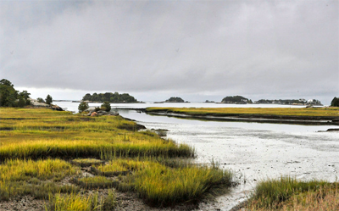
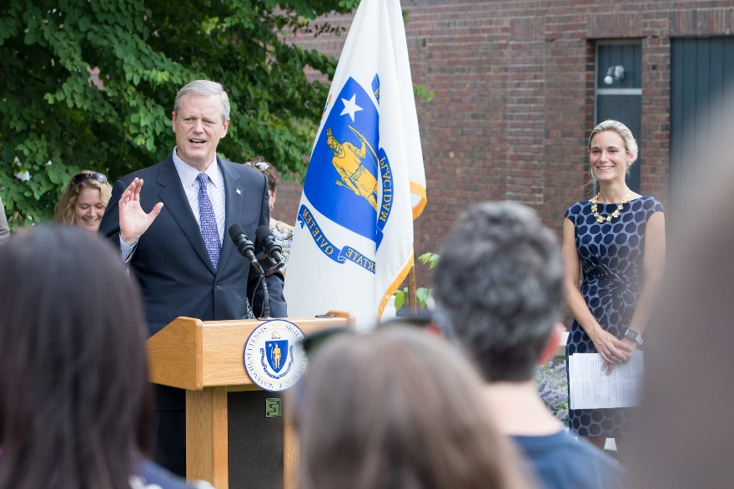
Next Steps: Climate Change & the Commonwealth
Bill S.10:
An Act for Climate Change Adaptation Infrastructure Investments in the Commonwealth
Building on success of existing programs like MVP: Proposed new source of revenue for loans, grants, and technical assistance to municipalities and regional partnerships for priority adaptation projects
Proposed deeds excise increase → est. $137M annually ($1B in ten years)
Recurring, long-term revenue stream for multi-year project feasibility
Notes:
We also wanted to note the importance of a current bill in front of the legislature to create a new, sustainable source of revenue to support climate change resilience implementation across the Commonwealth.
Governor Baker filed Senate Bill 10, An Act for Climate Change Adaptation Infrastructure Investments in the Commonwealth, that will dedicate an estimated $137million a year to the Global Warming Solutions Trust Fund through an increase in the deeds excise, a fee on the sale of property.
This funding would be a source of loans, grants, and technical assistance to municipalities, regional partnerships, and agencies to implement climate adaptation and resilience infrastructure projects with broad community benefits.

Slide 24
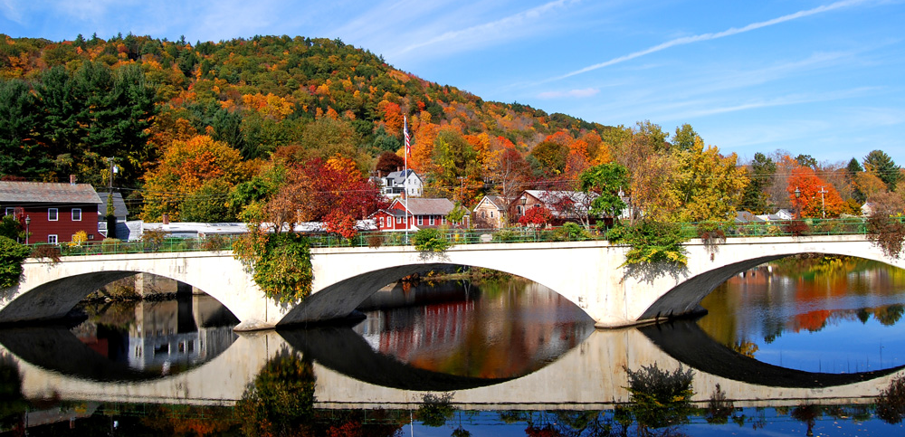
Mia.Mansfield@mass.gov
https://www.mass.gov/municipal-vulnerability-preparedness-program
https://www.mass.gov/municipal-vulnerability-preparedness-program

